Slide 1
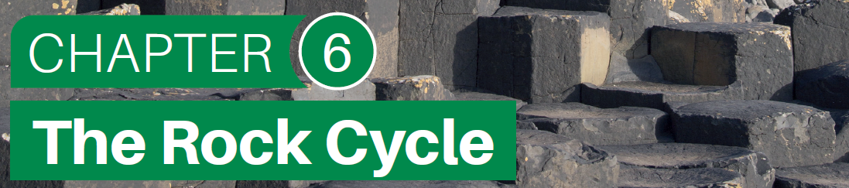
Chapter 6 is made up of the following sections:
Describing the rock cycle
Rock classification in Ireland
Igneous rock
Sedimentary rock
Metamorphic rock

Slide 2
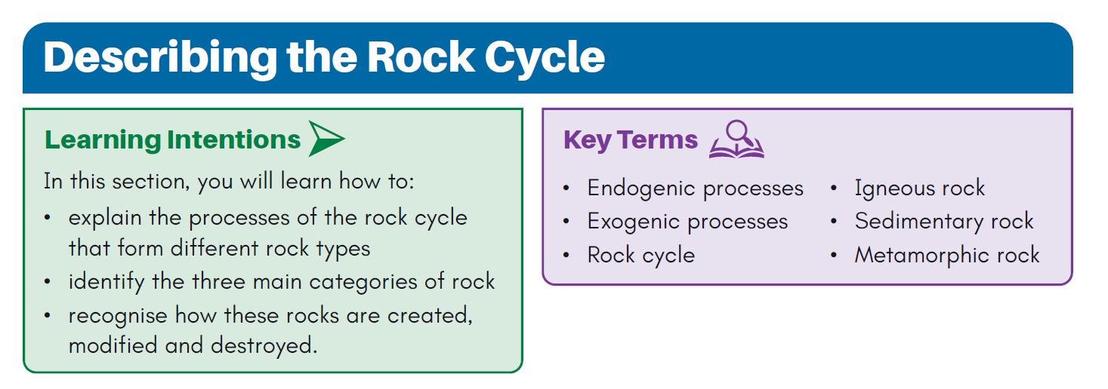
LESSON 1
Introduction to the Rock Cycle

Slide 3
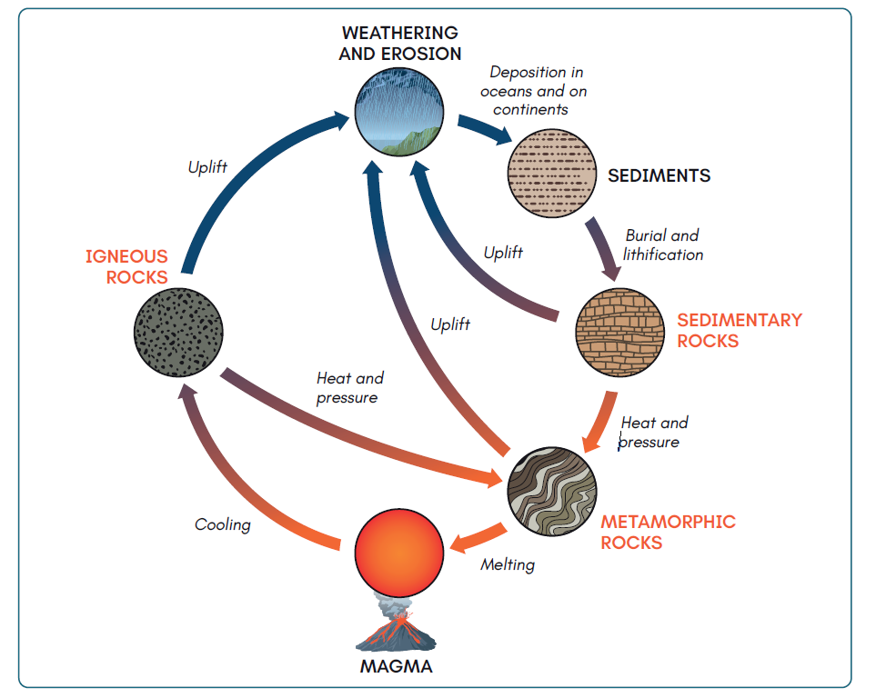
Describing the Rock Cycle
Three main groups of rocks:
1. Igneous
2. Sedimentary
3. Metamorphic
Igneous rock – created by volcanic activity.
This is broken into sediments by weathering and erosion.
Sediments are buried in the beds of lakes and seas, cementing together – lithification. This forms sedimentary rock.
Heat at plate boundaries or from magma changes igneous and sedimentary rock to metamorphic rock.
Metamorphic rock is broken down by weathering/erosion, forming sediments, or subducted and melted back into magma.

Slide 4
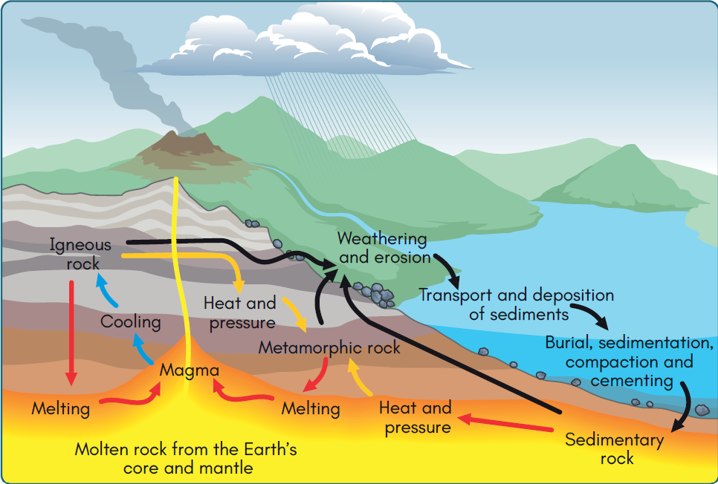
The Formation of Rocks

Slide 5

Test Yourself Questions

Slide 6

Test Yourself Solutions
3. Lithification is the process involving compaction and cementation, through which sediments are turned into solid rock

Slide 7
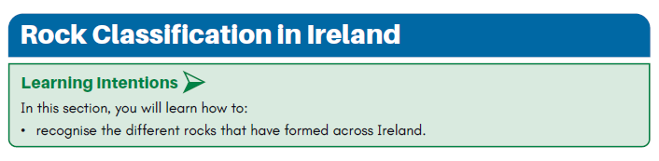
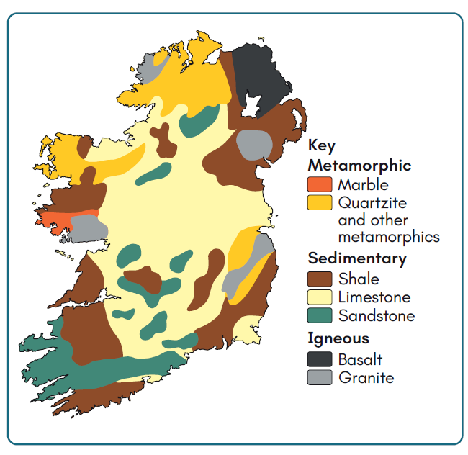
LESSON 2
Rock Classification in Ireland
This map shows the distribution of igneous, sedimentary and metamorphic rock across Ireland.

Slide 8
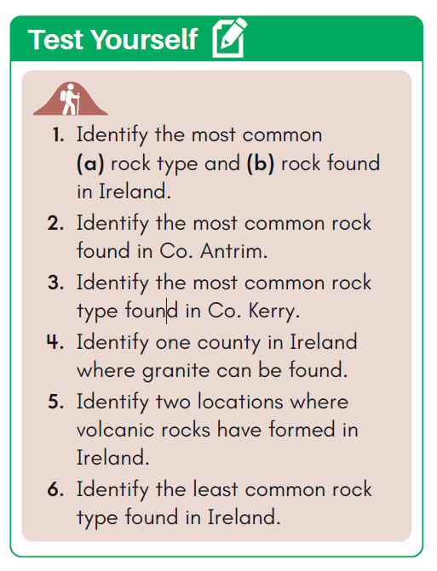
Test Yourself Questions

Slide 9
Test Yourself Solutions
a) Sedimentary rock
b) Limestone
Basalt
Sandstone
Wicklow
County Antrim and County Armagh
Marble

Slide 10
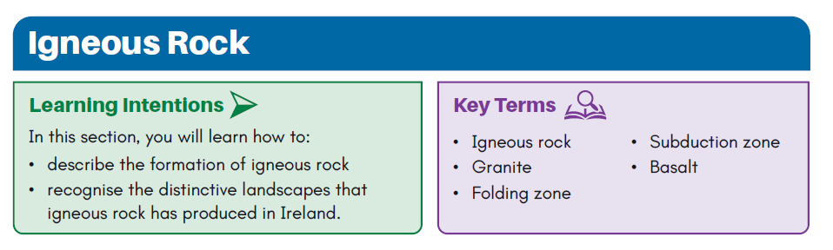
LESSON 3
Igneous Rock

Slide 11
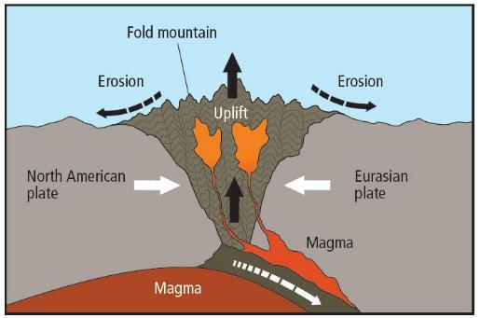
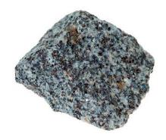
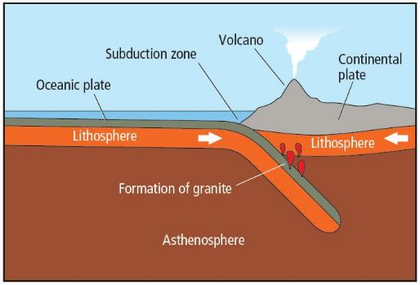
Granite
A coarse-grained, multi-coloured rock.
Forms mainly at convergent boundaries.
Made up of silica-rich minerals (quartz, feldspar and mica), making it resistant to weathering.
Found in the Wicklow Mountains.
Used in construction, and for kitchen countertops.
An intrusive/plutonic rock – forms when magma cools slowly inside the crust.
Forms through folding and subduction.

Slide 12
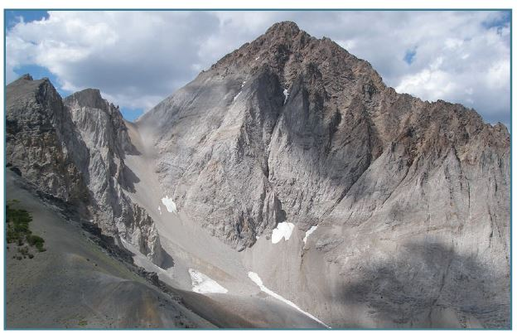
Granite
The Leinster Batholith is an example of a landscape associated with granite.
Largest area of granite in Ireland and surrounds the Dublin, Wicklow and Blackstairs mountains.
Formed roughly 400 million years ago during the Caledonian orogeny.
Layers of sedimentary rock buckled and magma rose and cooled slowly in the crust.
The heat from the magma cooked a thin layer of overlying sedimentary rock into metamorphic rock – known as an aureole, which protects the underlying granite from weathering.

Slide 13
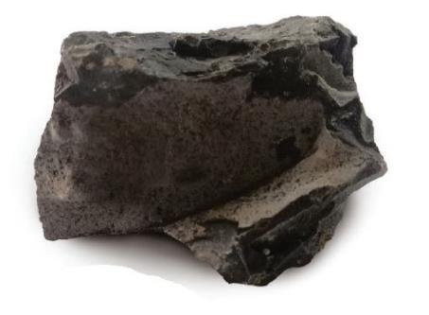
Basalt
A fine-grained, smooth-textured rock.
Made up of magnesium and iron, gives it a dull, rusty or black colour.
Formed the Antrim-Derry Plateau and the Giant’s Causeway.
Used for road chippings and floor tiles.
An extrusive rock, forms at divergent boundaries when lava cools rapidly on Earth’s surface.
It is the world’s most common rock.
New basalt is currently being created at the Mid-Atlantic Ridge.

Slide 14
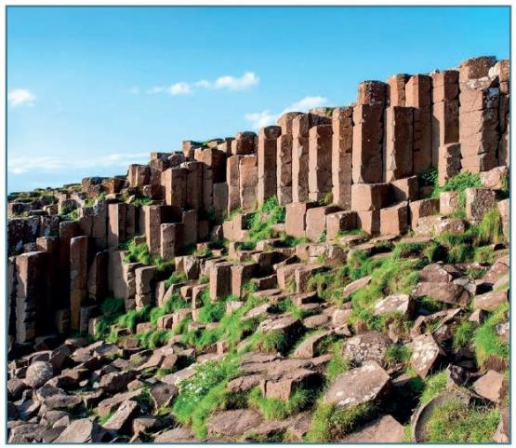
Basalt
The Antrim-Derry Plateau is an example of a landscape associated with basalt.
It formed 65 million years ago when the North American and Eurasian plates began to separate.
Plateau may have once been 1,800 m thick, but has since been worn down by weathering/erosion.
As basalt cooled and contracted, it split into a series of hexagonal columns. Can be seen at the Giant’s Causeway.

Slide 15
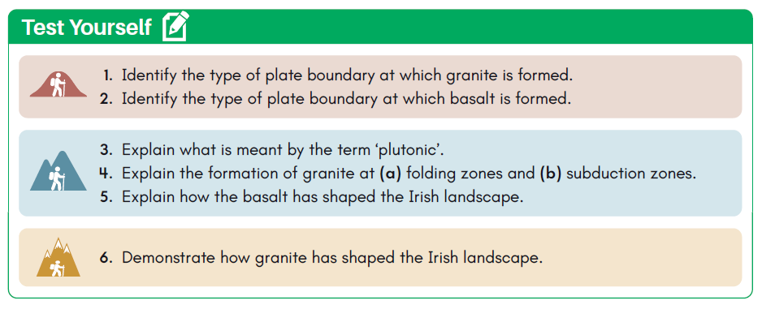
Test Yourself Questions

Slide 16
Test Yourself Solutions

Slide 17
Test Yourself Solutions

Slide 18
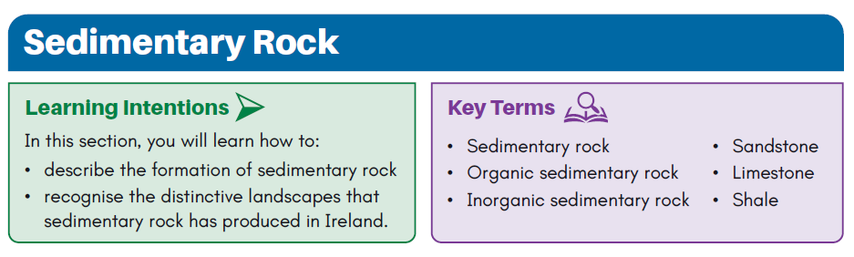
LESSON 4
Sedimentary Rock

Slide 19
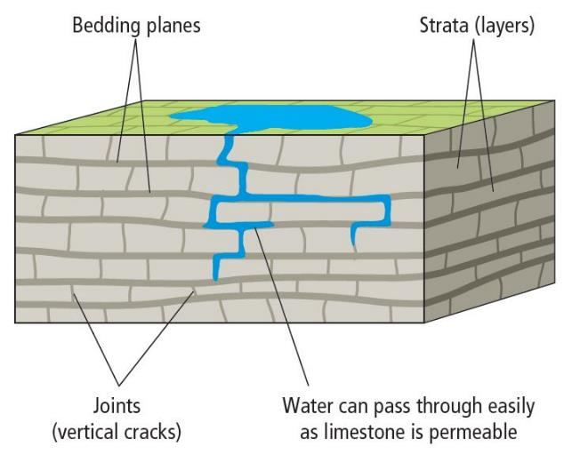
Introduction
Two groups:
Organic – formed from fossils of living things, e.g. plants, animals and sea creatures.
Inorganic – formed from broken down fragments of other rocks.
Have a unique structure:
Stratified – formed in layers, called strata.
Bottom layers are compacted together, cementation occurs to glue the sediments together. Eventually forms solid rock in a process called lithification.
Strata separated by dark horizontal lines – bedding planes.
Vertical cracks may also form, called joints.

Slide 20
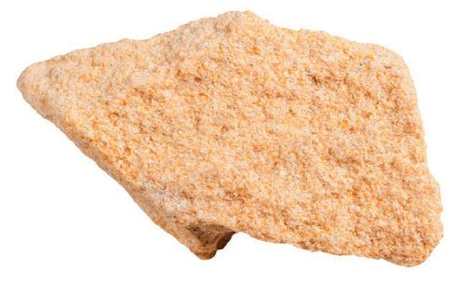
Sandstone
A coarse-grained, inorganic rock.
Sandstone in Ireland known as ‘Old Red Sandstone’ due to high iron oxide content.
Resistant to weathering/erosion.
Can be found in the Macgillycuddy’s Reeks in Co. Kerry.
Used for paving stones and building blocks.
Forms when grains of quartz are deposited in thick layers on land or in shallow seabeds.
Was created in Ireland roughly 380 million years ago when Ireland was located south of equator and was experiencing a desert climate.
As the peaks of newly formed Caledonian mountains were eroded, sediment was produced and deposited on seabed.
Iron and silica cemented the sediments, allowing lithification to occur.
E.g. Munster Ridge Valley.

Slide 21
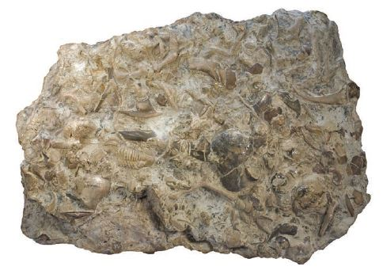
Limestone
A fine-grained and organic rock.
Pure limestone is called chalk and is white in colour.
Ireland’s lime is ‘carboniferous limestone’, contains over 50% calcium carbonate and is grey in colour.
Can be found in the Burren, Co. Clare.
Is used for cement and to reduce acidity of soil.
Formed in Ireland 320 million years ago when Ireland was submerged in a tropical sea close to equator.
Fossils of fish and other sea creatures built up and compressed. CaCO₃ cemented the fossils together, allowing lithification to occur.
Limestone is brittle and permeable.
A karst landscape is associated with limestone, e.g. the Burren.

Slide 22
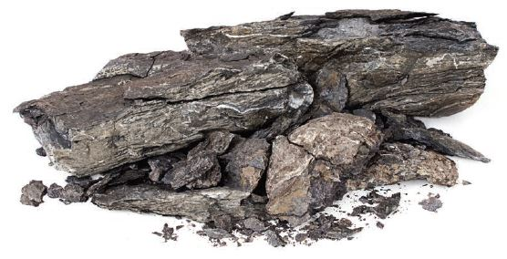
Shale
A fine-grained and inorganic rock.
Consists of very thin layers that give it a brittle or flakey texture, dark grey in colour.
Can be found at Slieve Elva in Co. Clare.
Is used for making ceramics and other pottery.
Shale is formed through the deposition of thick layers of silt and clay in shallow seawaters.
Quartz and calcite cemented the mud together and lithification occurred.
Made from fine particles and is soft, so it is easily broken down by weathering and erosion.

Slide 23
Other Examples of Sedimentary Rocks
Coal: An organic rock formed from the remains of plant fossils, compacted by silt before they were fully decomposed. It is used as a fossil fuel.
Conglomerates: Course-grained inorganic rock formed from the rounded fragments of other rocks that have been compacted and cemented together by quartz.
Gypsum: A chemical sedimentary rock formed from the compaction of sea salt.

Slide 24
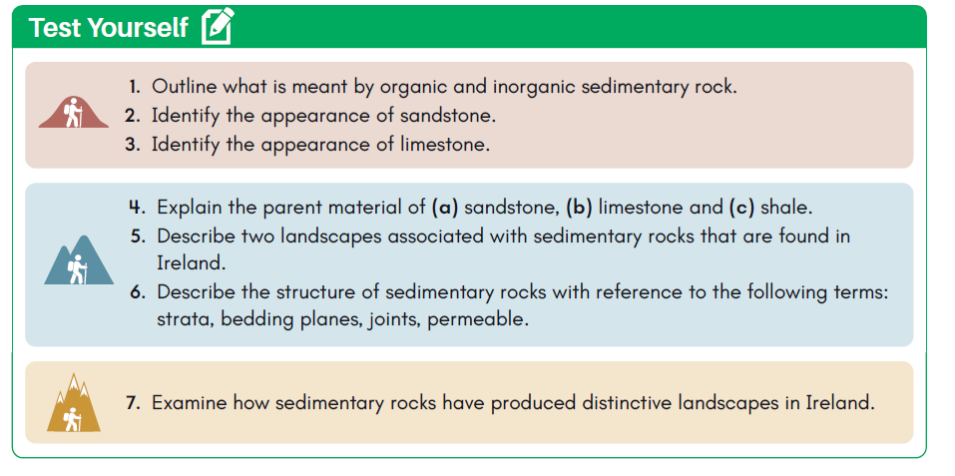
Test Yourself Questions

Slide 25
Test Yourself Solutions
Organic sedimentary rocks are formed from the fossils of living things, e.g. plants, animals or sea creatures. Inorganic sedimentary rocks form from the broken-down fragments of other rock.
Sandstone is a coarse-grained rock. Irish sandstone, known as Old Red Sandstone, is reddish brown in colour due to a high iron oxide content.
Limestone is a fine-grained rock that is white in colour when pure. However, most limestone has impurities that give it a grey colour.
(a) Sandstone: formed from sand particles.(b) Limestone: formed from shells and skeletons of marine organisms.(c) Shale: formed from clay and mud.
The Munster Ridge Valley (sandstone) and the karst region of the Burren (limestone).
Strata: Layered. Bedding planes: Dark horizontal lines that separate strata of sedimentary rock. Joints: Vertical cracks that form in rock’s strata. Permeable: Rock that allows water to pass through it.

Slide 26
Test Yourself Solutions
7. The Old Red Sandstone of Munster was uplifted during the Armorican folding period 250 million years ago. As the African and Eurasian plates collided, layers of sandstone and overlying limestone were buckled and uplifted above sea level. The overlying limestone was eroded away to reveal the sandstone ridges underneath. These ridges rise above the surrounding landscape to form Munster’s sandstone mountains. This landscape is called the Munster Ridge Valley. A unique landscape associated with limestone is the karst region of the Burren in Co. Clare. The Burren covers an area of 250 km2, covering most of North Clare, where it slopes gently into the Atlantic Ocean. The Burren remained submerged under a shallow tropical sea until the Armorican folding period. As the African and Eurasian plates collided, it was uplifted above sea level to its present location. The limestone remained protected by a layer of soil until the last ice age. During the ice age, large glaciers scraped the overlying soil away to reveal the underlying limestone. Once exposed, the limestone was then shaped by the chemical weathering process of carbonation. Carbonation occurs as limestone is dissolved by acidic rain. This process led to the formation of limestone pavement on the surface of the landscape.

Slide 27
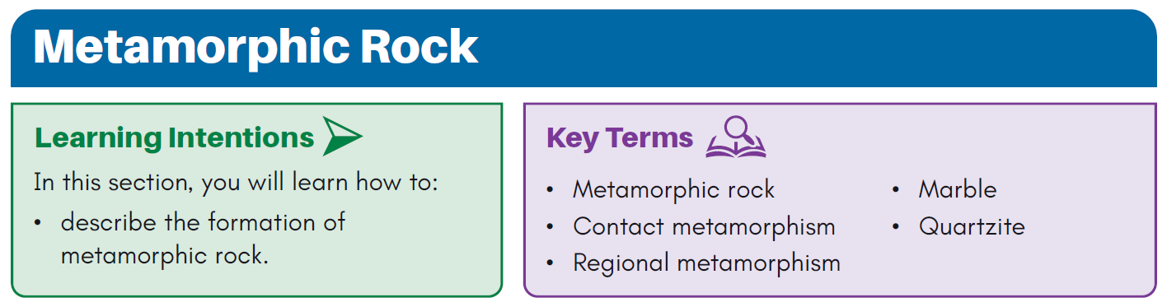
LESSON 5
Metamorphic Rock

Slide 28
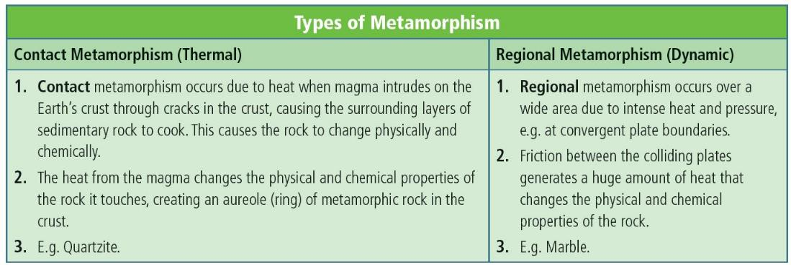
Introduction

Slide 29
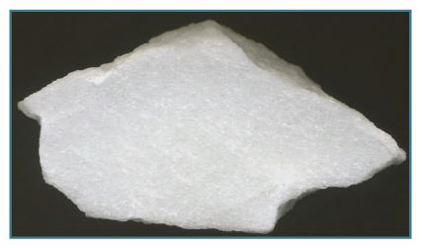
Marble
A course-grained, non-foliated rock, which forms when limestone is changed due to heat and pressure.
Pure marble is white, but varies in colour due to impurities.
Can be found in Connemara, Kilkenny and Cork.
Marble forms as a result of regional metamorphism, which alters the physical and chemical properties of limestone.
It forms at convergent plate boundaries, the intense heat melts away the remains of marine fossils and cause the limestone strata to melt together.
Calcite minerals expand and lock together as the rock continues to heat.

Slide 30
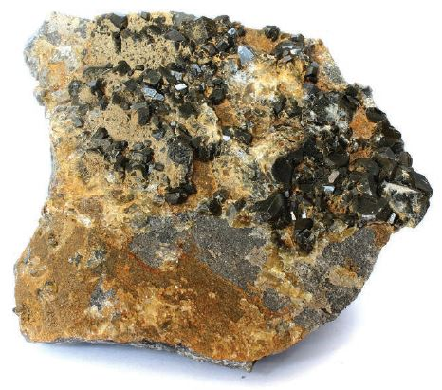
Quartzite
A coarse-grained, non-foliated rock which forms when sandstone is changed due to heat and pressure
It varies in colour but is typically pale pink.
It can be found on Mount Errigal in Co. Donegal.
It is used for kitchen countertops, while crushed quartzite is used for road chippings.
Formed from contact metamorphism, which alters the chemical and physical properties of sandstone.
Quartzite in Ireland formed 400 million years ago, when the North American and Eurasian plates collided.
Intense heat and pressure caused grains of sand to change into quartz, and silica minerals filled the pores to cement the quartz together.
Absence of pores and strata make it resistant to weathering and erosion.

Slide 31
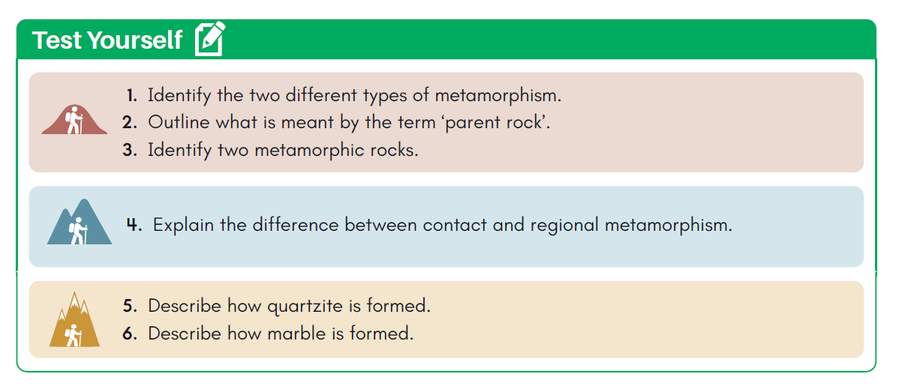
Test Yourself Questions

Slide 32
Test Yourself Solutions
Regional (dynamic) metamorphism and contact (thermal) metamorphism.
Parent rock refers to the original rock type from which another rock is formed. Road chippings (quartzite) and tiles or countertops (marble).
Marble, quartzite
Contact metamorphism occurs due to heat when magma intrudes on the Earth’s crust through cracks in the crust. This causes the surrounding layers of sedimentary rock to cook, changing it physically and chemically. The heat from the magma changes the physical and chemical properties of the rock it touches, creating an aureole of metamorphic rock in the crust, for example quartzite. Regional metamorphism occurs over a wide area due to intense heat and pressure at convergent plate boundaries. Friction between the colliding plates generates a huge amount of heat that changes the physical and chemical properties of the rock, for example marble.

Slide 33
Test Yourself Solutions
5. Quartzite is formed from contact metamorphism, which changes the physical and chemical properties of sandstone. Quartzite formed in Ireland 400 million years ago when the North American and Eurasian plates collided, folding layers of sedimentary rock. This process caused magma to force its way into the crust, where it came into contact with sandstone. This led to an increase in pressure, while the intense heat from the magma caused the temperature of the sandstone to soar. The intense heat and pressure caused the grains of sand in the rock to chemically change into quartz. During this process, silica minerals in the rock melt and fi ll the pores between the quartz to cement them together, while the stratifi ed structure of sandstone is also destroyed. The absence of pores and strata means that quartzite is a much harder rock than sandstone and therefore much more resistant to weathering and erosion.
6. Marble forms from regional metamorphism, which changes the physical and chemical properties of limestone. It forms at convergent plate boundaries due to the intense heat and pressure caused by friction between the two colliding plates. The intense heat melts away the remains of marine fossils and causes the different limestone strata to melt together. This means that marble is non-foliated rock. As the limestone rock continues to heat, calcite minerals in the rock expand and lock together. The intense heat causes these crystals to melt slightly, forcing them to stick together once they cool. Impurities in the limestone create marble of different colour. The presence of carbon has given Kilkenny marble a black colour, while iron oxide has led to red marble in Co. Cork. Connemara marble is green due to the presence of serpentine.

