Slide 1
Chapter 6 – Algebra 2: Equations and Inequalities

Slide 2
Chapter 6 content
Learning Outcomes: U.4, U.6, U.7, AF.2a, AF.2b, AF.2c, AF.4a, AF.4d
This chapter is made up of the following lessons:
6.1 Working with algebraic equations
6.2 Working with algebraic inequalities
6.3 Solving and graphing inequalities
In this chapter you will:
appreciate the difference between equations and expressions
apply inverse operations to solve one- and two-step equations
verify solutions of equations
graphically represent solutions to inequalities
solve one- and two-step inequalities

Slide 3
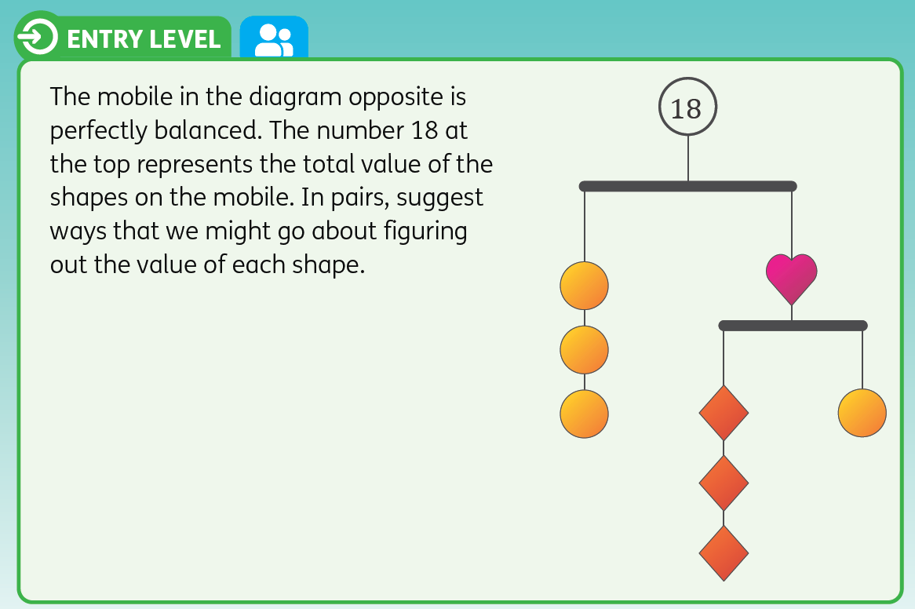

Slide 4
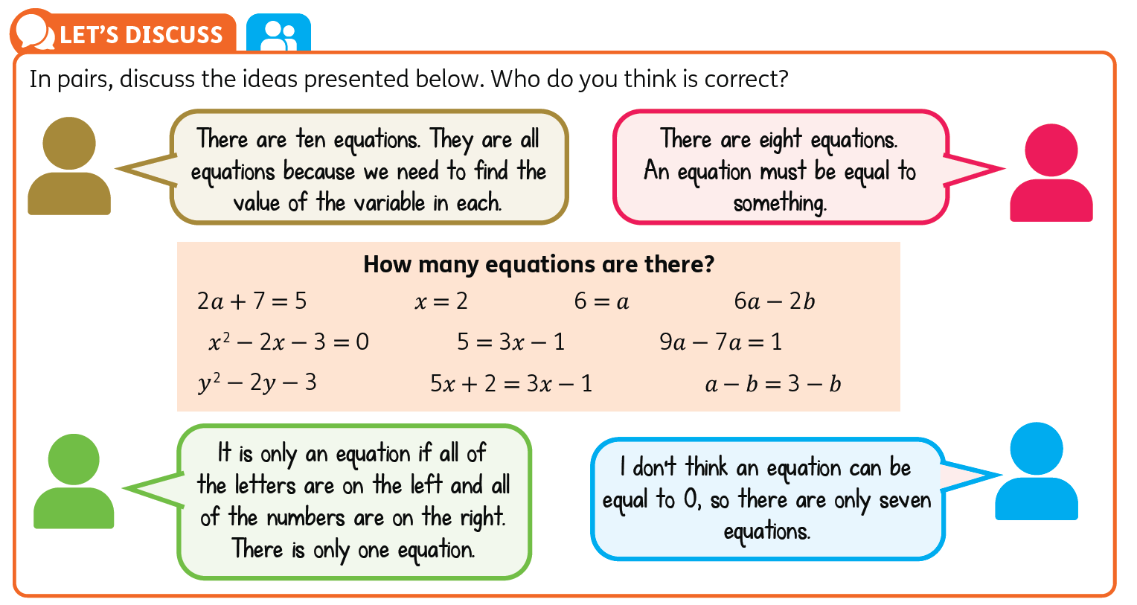
6.1 Working with algebraic equations

Slide 5
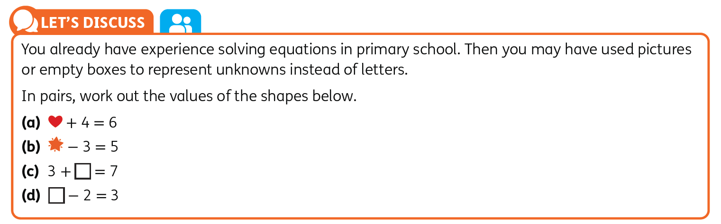
6.1 Working with algebraic equations

Slide 6
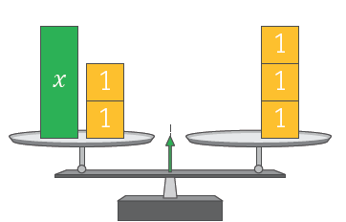
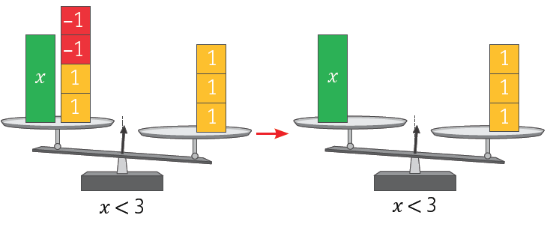
6.1 Working with algebraic equations
Example 6.1.1
Solve the equation.
(a) 𝑥 + 2 = 3
Solution
𝑥 + 2 = 3
The goal of solving an equation is to find out the exact value of the variable (𝑥). To do this we need to get 𝑥 on its own on one side of the equation and see what it balances with.
The 2 is currently adding (+) to the 𝑥 and stopping it from being on its own on the left-hand side of the equation. To get rid of the 2, we need to do the opposite of adding, which is subtracting (−), as they are inverse operations.
However, if we subtract the 2 from the left-hand side of the equation only, we upset the balance. We no longer have an equation but an inequality.
Remember: Whatever we do to one side of an equation, we must do to the other

Slide 7
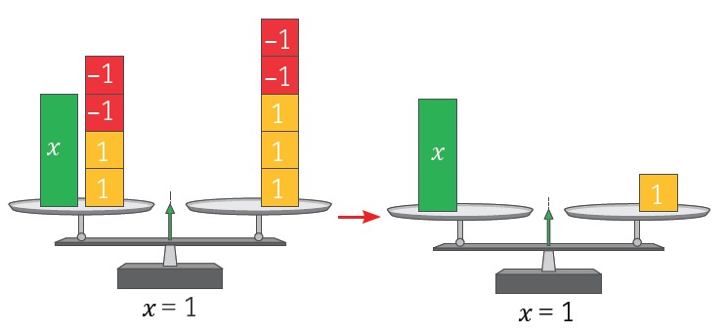
6.1 Working with algebraic equations
Solution
(a) 𝑥​ + 2 = 3
−2 −2
𝑥​ = 1
By subtracting 2 from both sides, we can see that 𝑥 on its own balances with 1. Therefore, the value of 𝑥 is 1.
𝑥​ + 2 = 3
(1) + 2 = 3
3 = 3
To check if your answer is correct, we can substitute in our value for 𝑥. If the left-hand side equals the right-hand side, we know our answer is correct.

Slide 8
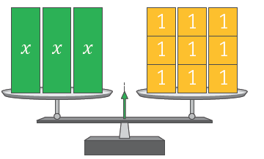
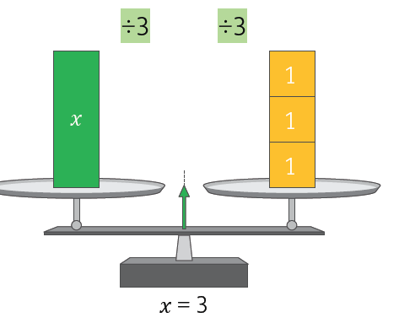

6.1 Working with algebraic equations
Example 6.1.1
Solve the equation.
(b) 3𝑥 = 9
Solution 6.1.1
(b) 3𝑥​ = 9
.
The 𝑥 has a coefficient of 3, which means it is being multiplied by 3. This is stopping the 𝑥 from being on its own on the left-hand side of the equation.
$\frac{3x}{3}$ = $\frac{9}{3}$
$(\frac{3}{ 3 })$𝑥 = $\frac{9}{3}$
1𝑥 = 3
𝑥 = 3
To get rid of the 3, we need to do
the opposite of multiplying, which is dividing. This needs to be done to both sides.
3𝑥 = 9
3(3) = 9
9 = 9
Verify your solution.

Slide 9
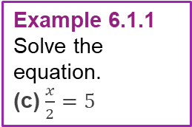

6.1 Working with algebraic equations
Example 6.1.1
Solve the equation.
(c) $\frac{x}{2}=5$
Solution 6.1.1
(c) $\frac{x}{2}=5$
×2 ×2
(2)$\frac{x}{2}$ = (2)5
($\frac{2}{2}) x=\left(2\right)5$
1$x$ = 10
$x$ =10
$\frac{x}{2}$ = 5
$$\frac{10}{2 }=5$$
5 = 5
What’s stopping 𝑥 from being on its own? The 2. What is the 2 doing? Dividing.
How do we undo it? Multiplying (use brackets to show multiply).
Verify your solution.

Slide 10

6.1 Working with algebraic equations
Example 6.1.2
Solve the equation.
(a) 2𝑥 + 1 = 5
Solution 6.1.2
(a) 2𝑥 + 1 = 5
In this equation there are two operations acting on the 𝑥:
• it is being multiplied by 2
and
• 1 is being added to it.
To get 𝑥 on its own we have to ‘undo’ all of the operations that are happening to it by using inverse operations.
This means that we invert the order of operations by doing them in reverse order. We will start with undoing the subtractions/additions first. Subtract 1 from both sides.
2𝑥 + 1 = 5
−1 − 1
2𝑥 = 4
÷2 ÷2
$$\frac{2x}{2}=\frac{4}{2}$$
𝑥 = 2
2𝑥 + 1 = 5
2(2) + 1 = 5
4 + 1 = 5
5 = 5
The 𝑥 has a coefficient of 2. This means it is being multiplied by 2. To undo this, we divide both sides by 2 to remove the coefficient
Verify your solution.

Slide 11



6.1 Working with algebraic equations
Example 6.1.2
Solve the equation.
(b) 5 − 3𝑥 = 11
Solution 6.1.2
We can start this question by rearranging the equation using the commutative property of addition of integers to get:
−3𝑥 + 5 = 11
Having the unknown term first in the equation makes it easier for us to see what operations are acting on it.
Now, we undo each of the operations, starting in reverse
order for the order of operations. There is a +5 being added to the 𝑥​. To undo it we will subtract 5 from both sides.
(b) 5 − 3𝑥 = 11
−3𝑥 + 5 = 11
$−$5 $−$5
−3𝑥 = 6
÷(−3) ÷(−3)
$$\frac{−3x}{(−3)}=\frac{6}{(−3)}$$
$$\frac{−3}{(−3)}x= \frac{6}{−3}$$
$x$ = $−$2
5 − 3𝑥 = 11
5 − 3(−2) = 11
5 + 6 = 11
11 = 11
The coefficient of 𝑥 is −3, which means that 𝑥 is being multiplied by −3. To undo this we use the inverse operation and divide both sides by −3.
Verify your solution.
Remember:

Slide 12
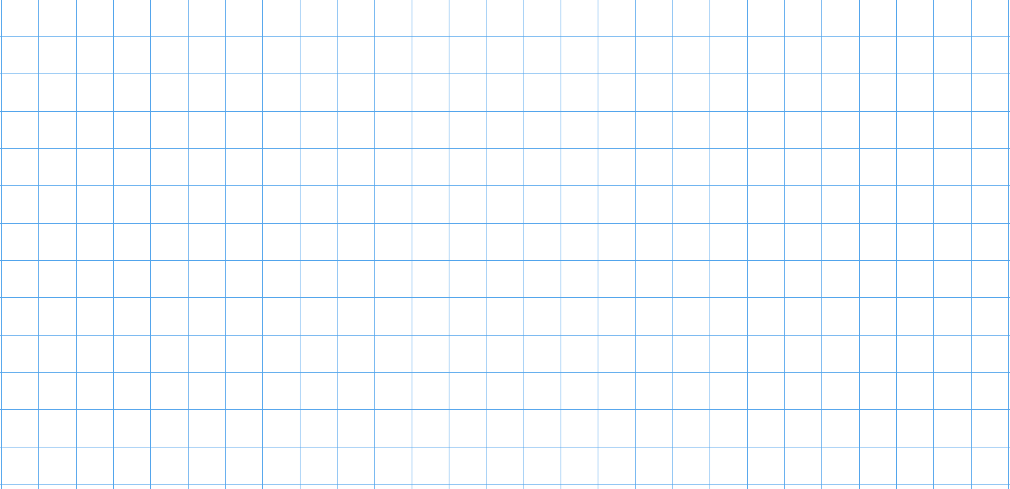
6.1 Working with algebraic equations – Exercise 6.1
Level 1
1. Describe in words what operations are acting on the 𝑥 term in each expression. Hence, write out the inverse operations of each. The first one has been done for you.
(a) 𝑥 + 2: Operation in words: add 2; Inverse operation: subtract 2
(b) 𝑥 − 7
(c) 𝑥 + 3
(d) 𝑥 − 1

Slide 13
6.1 Working with algebraic equations – Exercise 6.1
Level 1
2. Rewrite the following equations and fill in the missing steps, then solve the equation. The first one has been done for you.
(a) 𝑥 + 3 = 6
𝑥 = 3
(b) 𝑥 + 5 = 7
𝑥 = ___
(c) 𝑥 + 4 = 3
𝑥 = ___
(d) 𝑥 + 6 = –1
𝑥 = ___
(e) 𝑥 – 2 = 3
𝑥 = ___
(f) 𝑥 – 5 = – 4
𝑥 = ___
(g) 𝑥 – 4 = 3
𝑥 = ___
(h) 𝑥 – 5 = 11
𝑥 = ___
−3
− 3
− __
− __
+ __
+ __
− __
− __
+ __
+ __
+ __
+ __
− __
− __
+ __
+ __

Slide 14
6.1 Working with algebraic equations – Exercise 6.1
Level 1
3. (a) Spot the mistake and rewrite the correct solution into your copy.
(i) 𝑥 − 3 = 5
𝑥 = 5
​
+3

Slide 15
6.1 Working with algebraic equations – Exercise 6.1
Level 1
3. (a) Spot the mistake and rewrite the correct solution into your copy.
(ii) 𝑥 – 4 = 6
𝑥 = 2
−4
−4

Slide 16
6.1 Working with algebraic equations – Exercise 6.1
Level 1
3. (a) Spot the mistake and rewrite the correct solution into your copy.
(iii) 7 = 𝑥 – 3
10 = 𝑥 + 3
7 = 𝑥
+3
+3
− 3
− 3

Slide 17
6.1 Working with algebraic equations – Exercise 6.1
Level 1
3. (a) Spot the mistake and rewrite the correct solution into your copy.
(iv) –13 = 𝑥 + 15
+28 = 𝑥
–15
– 15

Slide 18
6.1 Working with algebraic equations – Exercise 6.1
Level 1
3. (b) How could the student have checked that their answers were correct?

Slide 19
6.1 Working with algebraic equations – Exercise 6.1
Level 1
4. Solve each of the following equations. Don’t forget to verify your answers as you go.
(a) 𝑎 + 1 = 5 (b) 𝑏 + 6 = 13 (c) 4 = 𝑐 + 2

Slide 20
6.1 Working with algebraic equations – Exercise 6.1
Level 1
4. Solve each of the following equations. Don’t forget to verify your answers as you go.
(d) 𝑑 − 3 = 1 (e) 𝑒 − 7 = 3 (f) 5 = 𝑓 − 3

Slide 21
6.1 Working with algebraic equations – Exercise 6.1
Level 1
4. Solve each of the following equations. Don’t forget to verify your answers as you go.
(g) 𝑔 − 5 = −1 (h) 7 = ℎ − 3 (i) 𝑖 + 4 = −4

Slide 22
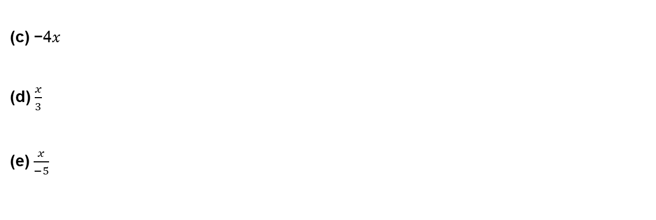
6.1 Working with algebraic equations – Exercise 6.1
Level 2
1. Describe in words what operations are acting on the 𝑥 term in each expression. Hence, write out the inverse operations of each. The first one has been done for you.
(a) 2𝑥: Operation in words: multiply by 2; Inverse operation: divide by 2
(b) −2𝑥
(c) −4𝑥
(d) $\frac{x}{3}$
(e) $\frac{x}{−5}$

Slide 23


6.1 Working with algebraic equations – Exercise 6.1
Level 2
2. Rewrite the following equations and fill in the missing steps, then solve the equation. The first one has been done for you.
(a) 5𝑥 = 15 (c) −4𝑥 = 8 (e) 3 = $\frac{x}{3}$
𝑥 = 3
(b) $\frac{x}{3}=4$ (d) $\frac{x}{−2}=6$ (f) –6 = 2𝑥
(g) –18 = –3 𝑥
(h) – 20 = $\frac{x}{−5}$
÷5
÷5
÷ __
÷ __
× __
× __
÷ __
÷ __
× __
× __
× __
× __
÷ __
÷ __
× __
× __

Slide 24
6.1 Working with algebraic equations – Exercise 6.1
Level 2
3. (a) Spot the mistake and rewrite the correct solution into your copy.
(i) 3𝑥 = 9
𝑥 = 6
–3
–3

Slide 25
6.1 Working with algebraic equations – Exercise 6.1
Level 2
3. (a) Spot the mistake and rewrite the correct solution into your copy.
(ii) 6 = −2𝑥
8 = 𝑥
+2
+2

Slide 26

6.1 Working with algebraic equations – Exercise 6.1
Level 2
3. (a) Spot the mistake and rewrite the correct solution into your copy.
(iii) $\frac{x}{4}$ = 8
𝑥 = 2
÷4
÷4

Slide 27
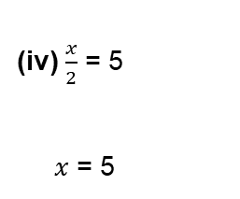
6.1 Working with algebraic equations – Exercise 6.1
Level 2
3. (a) Spot the mistake and rewrite the correct solution into your copy.
(iv) $\frac{x}{2}$ = 5
𝑥​ = 5
×2

Slide 28

6.1 Working with algebraic equations – Exercise 6.1
Level 2
3. (a) Spot the mistake and rewrite the correct solution into your copy.
(v) –3 = $\frac{x}{−4}$
−12 = 𝑥​
×4
×4

Slide 29
6.1 Working with algebraic equations – Exercise 6.1
Level 2
3. (b) How could the student have verified their answers?

Slide 30
6.1 Working with algebraic equations – Exercise 6.1
Level 2
4. Solve each of the following equations. Don’t forget to verify your answers as you go.
(a) 3𝑎 = 6 (b) 4𝑏 = 12 (c) 2𝑐 = 8

Slide 31
6.1 Working with algebraic equations – Exercise 6.1
Level 2
4. Solve each of the following equations. Don’t forget to verify your answers as you go.
(d) 4𝑑 = 16 (e) 5𝑒 = −25 (f) −10 = −2𝑓

Slide 32
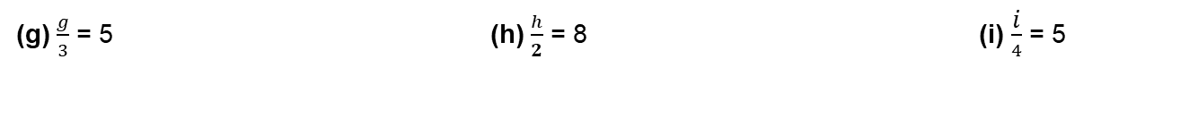
6.1 Working with algebraic equations – Exercise 6.1
Level 2
4. Solve each of the following equations. Don’t forget to verify your answers as you go.
(g) $\frac{g}{3}$ = 5 (h) $\frac{h}{2}$ = 8 (i) $\frac{\text{i}}{4}$ = 5

Slide 33
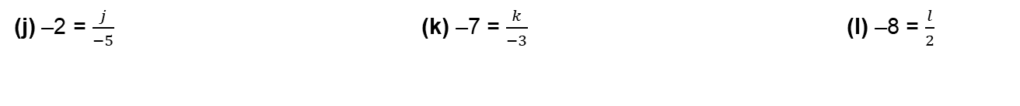
6.1 Working with algebraic equations – Exercise 6.1
Level 2
4. Solve each of the following equations. Don’t forget to verify your answers as you go.
(j) –2 = $\frac{j}{−5}$ (k) –7 = $\frac{k}{−3}$(l) –8 = $\frac{l}{2}$

Slide 34

6.1 Working with algebraic equations – Exercise 6.1
Level 3
1. Describe in words, in the order that they happen, what operations are acting on the 𝑥 term in each
expression. Hence, write out the inverse operations of each. The first one has been done for you.
(a) 2𝑥​ + 1: Operations: multiply by 2, add 1; Inverse operations: subtract 1, divide by 2
(b) 3𝑥 − 7
(c) −2𝑥 + 4
(d) $\frac{x}{3}$ − 1
(e) $\frac{x}{5}$ + 2

Slide 35

6.1 Working with algebraic equations – Exercise 6.1
Level 3
2. Fill in the blanks below in your copy to complete the solving process. Blue boxes represent operations and green boxes represent answers.
(a) 3𝑥 + 1 = 7
3𝑥 = 6
𝑥 = 2
(b) 2𝑥 – 3 = 5
2𝑥 = 8
𝑥 =
(c) $\frac{x}{2}$ – 1 = 3
$\frac{x}{2}$ =
𝑥 =
(d) 2 − 𝑥 = 6
−𝑥 =
𝑥 = −4

Slide 36
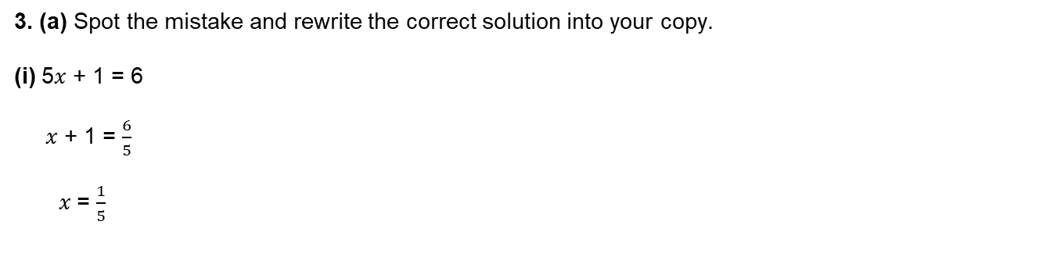
6.1 Working with algebraic equations – Exercise 6.1
Level 3
3. (a) Spot the mistake and rewrite the correct solution into your copy.
(i) 5𝑥 + 1 = 6
𝑥 + 1 = $\frac{6}{5}$
𝑥 = $\frac{1}{5}$
÷5
÷5
– 1
– 1

Slide 37
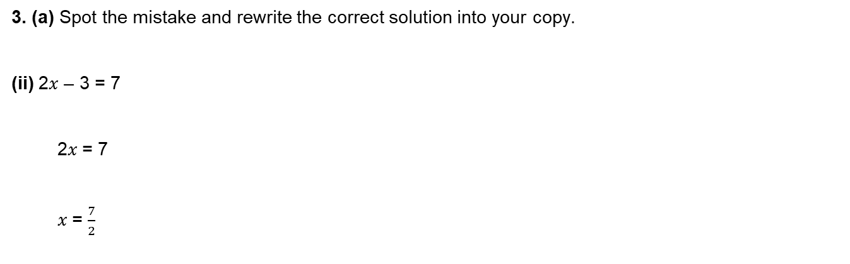
6.1 Working with algebraic equations – Exercise 6.1
Level 3
3. (a) Spot the mistake and rewrite the correct solution into your copy.
(ii) 2𝑥 – 3 = 7
2𝑥 = 7
𝑥 = $\frac{7}{2}$
+3
÷2
÷2

Slide 38

6.1 Working with algebraic equations – Exercise 6.1
Level 3
3. (a) Spot the mistake and rewrite the correct solution into your copy.
(iii) $\frac{x}{2}$ + 2 = 6
$\frac{x}{2}$ = 8
𝑥 = 4
– 2
– 2
÷2
÷2

Slide 39

6.1 Working with algebraic equations – Exercise 6.1
Level 3
3. (a) Spot the mistake and rewrite the correct solution into your copy.
(iv) 3 – 2$x$ = 5
2𝑥 = 8
𝑥 = 4
+3
+3
÷2
÷2

Slide 40
6.1 Working with algebraic equations – Exercise 6.1
Level 3
3. (b) How could the student have verified their answers?

Slide 41
6.1 Working with algebraic equations – Exercise 6.1
Level 3
4. Solve each of the following equations.
(a) 3𝑎 + 1 = 7 (b) 2𝑏 + 3 = 17 (c) −𝑐 + 2 = 5

Slide 42
6.1 Working with algebraic equations – Exercise 6.1
Level 3
4. Solve each of the following equations.
(d) 2 − 3𝑑 = 14 (e) $\frac{e}{4}$ + 2 = 5 (f) $\frac{f}{3}$ + 4 = 6

Slide 43
6.1 Working with algebraic equations – Exercise 6.1
Level 3
4. Solve each of the following equations.
(g) $\frac{g}{4}$ + 2 = 42 (h) $\frac{2h}{5}$ − 3 = 1 (i) −4𝑖 − 3 = −7 (j) 8 = −2 + 5𝑗​

Slide 44
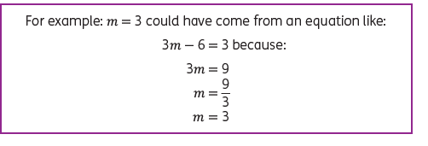
Bonus Level
6.1 Working with algebraic equations – Exercise 6.1
Create your own equation. If these are the answers, what are the questions?
(a) 𝑡 = 1

Slide 45
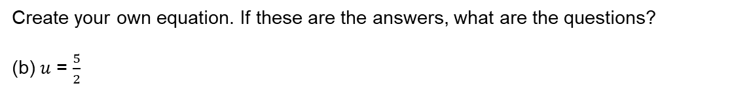
Bonus Level
6.1 Working with algebraic equations – Exercise 6.1
Create your own equation. If these are the answers, what are the questions?
(b) 𝑢 = $\frac{5}{2}$

Slide 46
Bonus Level
6.1 Working with algebraic equations – Exercise 6.1
Create your own equation. If these are the answers, what are the questions?
(c) 𝑣 = −1

Slide 47
Bonus Level
6.1 Working with algebraic equations – Exercise 6.1
Create your own equation. If these are the answers, what are the questions?
(d) 𝑥 = 7

Slide 48
Bonus Level
6.1 Working with algebraic equations – Exercise 6.1
Create your own equation. If these are the answers, what are the questions?
(e) 𝑦 = −3

Slide 49
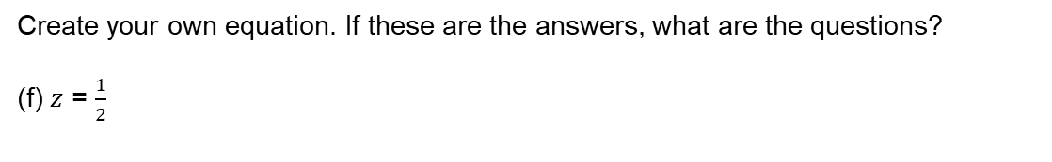
Bonus Level
6.1 Working with algebraic equations – Exercise 6.1
Create your own equation. If these are the answers, what are the questions?
(f) 𝑧 = $\frac{1}{2}$

Slide 50
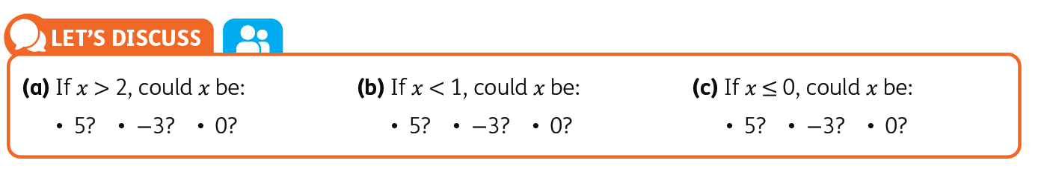
6.2 Working with algebraic inequalities

Slide 51
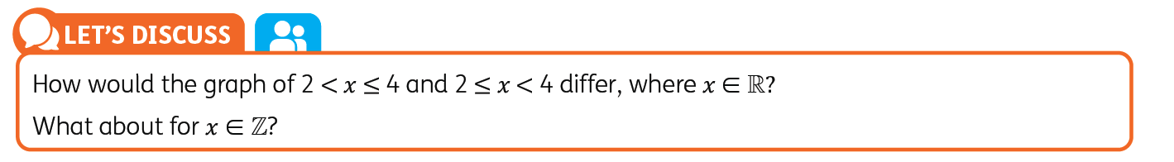
6.2 Working with algebraic inequalities

Slide 52
6.2 Working with algebraic inequalities – Exercise 6.2
Level 1
1. Place the correct inequality symbol > , ≥ , < , ≤ in each mathematical statement.
(a) 𝑎 is greater than 3
𝑎 ____ 3
(b) 𝑏 is less than or equal to 7
𝑏 ____7
(c) 𝑐 is greater than or equal to −1
𝑐 ____ −1
(d) 𝑑 is equal to −5
𝑑 ____ −5
(e) 𝑒 is less than 7
𝑒 ____ 7
(f) 𝑓 is less than or equal to 4
𝑓 ____ 4
(g) 𝑔 is greater than 2 and less than 6
2____ 𝑔 ____6
(h) ℎ is greater than or equal to −3 and less
than 7
−3____ ℎ ____7

Slide 53
6.2 Working with algebraic inequalities – Exercise 6.2
Level 1
2. Fill in the blanks using ℕ, ℝ, ℤ .
(a)
This is the graph of 𝑥 ≤ 3, where 𝑥 ∈ ____
(b)
This is the graph of 𝑥 < 3, where 𝑥 ∈ ____

Slide 54
6.2 Working with algebraic inequalities – Exercise 6.2
Level 1
2. Fill in the blanks using ℕ, ℝ, ℤ.
(c)
This is the graph of 𝑥 < 3, where 𝑥 ∈ ____
(d)
This is the graph of 𝑥 ≤ 3, where 𝑥 ∈ ____
(e)
This is the graph of 𝑥 < 3, where 𝑥 ∈ ____

Slide 55
6.2 Working with algebraic inequalities – Exercise 6.2
Level 2
1. (a) Max is struggling with the problem below. The question asks students to examine the number
line and express it using mathematical notation. He is unsure whether it should be 𝑥 ≤ 5, 𝑥 ∈ ℕ
or 𝑥 ≥ 0, 𝑥 ∈ ℤ.
(i) What advice can you give Max to help him figure it out?
(ii) Sergio says that it could also be written as: 0 ≤ 𝑥 ≤ 5, 𝑥 ∈ ℤ. Is he correct?

Slide 56

6.2 Working with algebraic inequalities – Exercise 6.2
Level 2
1. (b) Sarah says it’s impossible to draw the inequality 𝑥 < 1 , 𝑥 ∈ ℕ. Jack disagrees and draws the
diagram below.
Who is correct? Explain your choice.

Slide 57
6.2 Working with algebraic inequalities – Exercise 6.2
Level 2
1. (c) Elija says there are at least three ways to describe the graph below using mathematical notation. Is this true? If so, what are they?

Slide 58
6.2 Working with algebraic inequalities – Exercise 6.2
Level 2
2. Graph the following inequalities on a number line.
(a) 𝑥 < 5, 𝑥 ∈ ℕ

Slide 59
6.2 Working with algebraic inequalities – Exercise 6.2
Level 2
2. Graph the following inequalities on a number line.
(b) 𝑥 ≤ 5, 𝑥 ∈ ℕ

Slide 60
6.2 Working with algebraic inequalities – Exercise 6.2
Level 2
2. Graph the following inequalities on a number line.
(c) 𝑥 > 5, 𝑥 ∈ ℕ

Slide 61
6.2 Working with algebraic inequalities – Exercise 6.2
Level 2
2. Graph the following inequalities on a number line.
(d) 𝑥 > 3, 𝑥 ∈ ℤ

Slide 62
6.2 Working with algebraic inequalities – Exercise 6.2
Level 2
2. Graph the following inequalities on a number line.
(e) 𝑥 < 3, 𝑥 ∈ ℤ

Slide 63
6.2 Working with algebraic inequalities – Exercise 6.2
Level 2
2. Graph the following inequalities on a number line.
(f) 𝑥 ≤ 3, 𝑥 ∈ ℤ

Slide 64
6.2 Working with algebraic inequalities – Exercise 6.2
Level 2
2. Graph the following inequalities on a number line.
(g) 𝑥 ≤ 4, 𝑥 ∈ ℝ

Slide 65
6.2 Working with algebraic inequalities – Exercise 6.2
Level 2
2. Graph the following inequalities on a number line.
(h) 𝑥 < 4, 𝑥 ∈ ℝ

Slide 66
6.2 Working with algebraic inequalities – Exercise 6.2
Level 2
2. Graph the following inequalities on a number line.
(i) 𝑥 ≥ −4, 𝑥 ∈ ℝ

Slide 67
6.2 Working with algebraic inequalities – Exercise 6.2
Level 3
1. Sort the numbers below into the correct categories where 𝑥 ∈ ℤ in each case. Numbers may appear
in more than one column.
−8, −7, −6, −5, −4, −3, −2, −1, 0, 1, 2, 3, 4, 5, 6, 7, 8
− 5 < 𝑥 ≤ 0 | 1 < 𝑥 ≤ 3 | − 7 ≤ 𝑥 < 5 | 7 > 𝑥 ≥ 3

Slide 68
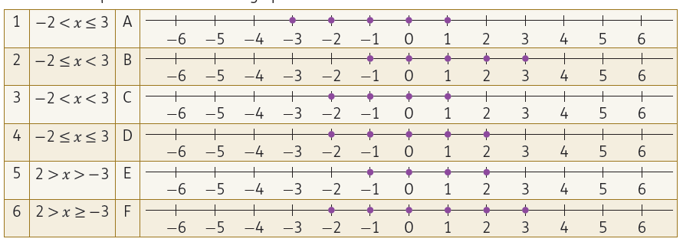
6.2 Working with algebraic inequalities – Exercise 6.2
Level 3
2. Match the inequalities to the correct graph where 𝑥 ∈ ℤ in each case.
1 = ___ 2 = ___ 3 = ___ 4 = ___ 5 = ___ 6 = ___

Slide 69
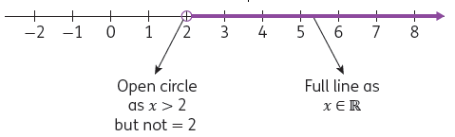
6.3 Solving and graphing inequalities
Example 6.3.1
Find the range of values for 𝑥 for which: 2𝑥 + 1 > 5, 𝑥 ∈ ℝ
Graph your solution on a number line.
Solution 6.3.1
2𝑥 + 1 > 5, 𝑥 ∈ ℝ
−1 −1
2𝑥 > 4
÷2 ÷2
𝑥 > 2
Inequalities can be solved in the same way as an equation.
We follow the reverse order of operations, so start by subtracting 1 from both sides
We follow this by dividing both sides by 2.
Then complete the number line, taking note of the type of number 𝑥 is an element of.
The solution and graph tell us that 𝑥 is any real number, greater than but not equal to 2.

Slide 70
6.3 Solving and graphing inequalities – Exercise 6.3
Level 1
Find the range of values for each of the following and graph your solution on a number line.
(a) 𝑥 + 2 ≥ 4, 𝑥​ ∈ ℤ

Slide 71
6.3 Solving and graphing inequalities – Exercise 6.3
Level 1
Find the range of values for each of the following and graph your solution on a number line.
(b) 𝑥 + 1 < 3, 𝑥 ∈ ℝ

Slide 72
6.3 Solving and graphing inequalities – Exercise 6.3
Level 1
Find the range of values for each of the following and graph your solution on a number line.
(c) 𝑥 + 3 ≤ 7, 𝑥 ∈ ℕ

Slide 73
6.3 Solving and graphing inequalities – Exercise 6.3
Level 1
Find the range of values for each of the following and graph your solution on a number line.
(d) 𝑥 − 2 ≤ 3, 𝑥 ∈ ℕ

Slide 74
6.3 Solving and graphing inequalities – Exercise 6.3
Level 1
Find the range of values for each of the following and graph your solution on a number line.
(e) 𝑥 − 4 > 3, 𝑥 ∈ ℤ

Slide 75
6.3 Solving and graphing inequalities – Exercise 6.3
Level 1
Find the range of values for each of the following and graph your solution on a number line.
(f) 𝑥 − 1 ≤ 3, 𝑥 ∈ ℝ

Slide 76
6.3 Solving and graphing inequalities – Exercise 6.3
Level 1
Find the range of values for each of the following and graph your solution on a number line.
(g) 𝑥 − 4 ≥ 4, 𝑥 ∈ ℤ

Slide 77
6.3 Solving and graphing inequalities – Exercise 6.3
Level 1
Find the range of values for each of the following and graph your solution on a number line.
(h) 𝑥 − 6 < − 1, 𝑥 ∈ ℕ

Slide 78
6.3 Solving and graphing inequalities – Exercise 6.3
Level 1
Find the range of values for each of the following and graph your solution on a number line.
(i) 𝑥 − 5 < 1, 𝑥 ∈ ℝ

Slide 79
6.3 Solving and graphing inequalities – Exercise 6.3
Level 2
Find the range of values for each of the following and graph your solution on a number line.𝑥
(a) 3𝑥 < 9, 𝑥 ∈ ℝ

Slide 80
6.3 Solving and graphing inequalities – Exercise 6.3
Level 2
Find the range of values for each of the following and graph your solution on a number line.𝑥
(b) 2𝑥 ≥ −6, 𝑥​ ∈ ℤ

Slide 81
6.3 Solving and graphing inequalities – Exercise 6.3
Level 2
Find the range of values for each of the following and graph your solution on a number line.𝑥
(c) 4𝑥 ≤ 4, 𝑥 ∈ ℕ

Slide 82
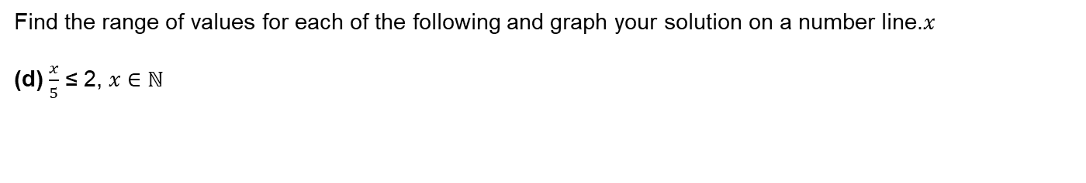
6.3 Solving and graphing inequalities – Exercise 6.3
Level 2
Find the range of values for each of the following and graph your solution on a number line.𝑥
(d) $\frac{x}{5}$ ≤ 2, 𝑥 ∈ ℕ

Slide 83
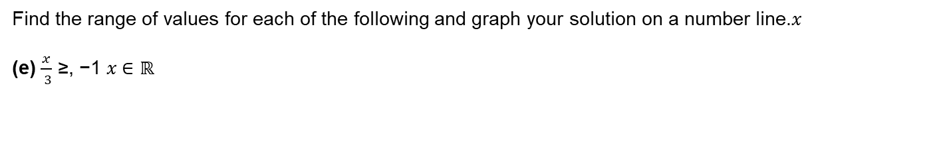
6.3 Solving and graphing inequalities – Exercise 6.3
Level 2
Find the range of values for each of the following and graph your solution on a number line.𝑥
(e) $\frac{x}{ 3}$ ≥, −1 𝑥 ∈ ℝ

Slide 84
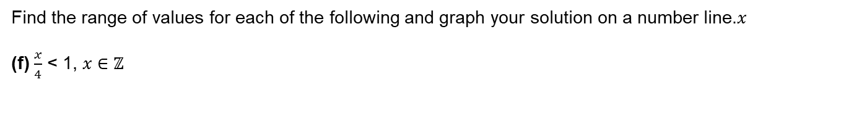
6.3 Solving and graphing inequalities – Exercise 6.3
Level 2
Find the range of values for each of the following and graph your solution on a number line.𝑥
(f) $\frac{x}{4}$ < 1, 𝑥​ ∈ ℤ

Slide 85
6.3 Solving and graphing inequalities – Exercise 6.3
Level 2
Find the range of values for each of the following and graph your solution on a number line.𝑥
(g) −𝑥 ≥ 5, 𝑥​ ∈ ℤ

Slide 86
6.3 Solving and graphing inequalities – Exercise 6.3
Level 2
Find the range of values for each of the following and graph your solution on a number line.𝑥
(h) −𝑥 < −3, 𝑥 ∈ ℕ

Slide 87
6.3 Solving and graphing inequalities – Exercise 6.3
Level 2
Find the range of values for each of the following and graph your solution on a number line.𝑥
(i) −2𝑥 ≤ 4, 𝑥​ ∈ ℤ

Slide 88
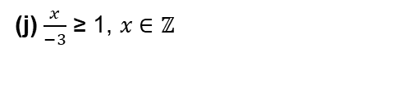
6.3 Solving and graphing inequalities – Exercise 6.3
Level 2
Find the range of values for each of the following and graph your solution on a number line.𝑥
(j) $\frac{x}{−3}$ ≥ 1, 𝑥 ∈ ℤ

Slide 89

6.3 Solving and graphing inequalities – Exercise 6.3
Level 2
Find the range of values for each of the following and graph your solution on a number line.𝑥
(k) $\frac{x}{−2}$ < 2, 𝑥 ∈ ℝ

Slide 90

6.3 Solving and graphing inequalities – Exercise 6.3
Level 2
Find the range of values for each of the following and graph your solution on a number line.𝑥
(l) $\frac{x}{−3}$ > −1, 𝑥 ∈ ℕ

Slide 91
6.3 Solving and graphing inequalities – Exercise 6.3
Level 3
Find the range of values for each of the following and graph your solution on a number line.
(a) 2𝑎 + 2 > 6, 𝑎 ∈ ℤ

Slide 92
6.3 Solving and graphing inequalities – Exercise 6.3
Level 3
Find the range of values for each of the following and graph your solution on a number line.
(b) 3𝑏 + 4 ≤ 10, 𝑏 ∈ ℕ

Slide 93
6.3 Solving and graphing inequalities – Exercise 6.3
Level 3
Find the range of values for each of the following and graph your solution on a number line.
(c) 5𝑐 + 5 < 0, 𝑐 ∈ ℤ

Slide 94
6.3 Solving and graphing inequalities – Exercise 6.3
Level 3
Find the range of values for each of the following and graph your solution on a number line.
(d) 3𝑑 − 5 > −2, 𝑑 ∈ ℝ

Slide 95
6.3 Solving and graphing inequalities – Exercise 6.3
Level 3
Find the range of values for each of the following and graph your solution on a number line.
(e) 2𝑒 − 6 < −2, 𝑒 ∈ ℕ

Slide 96
6.3 Solving and graphing inequalities – Exercise 6.3
Level 3
Find the range of values for each of the following and graph your solution on a number line.
(f) 5𝑓 + 1 > −4, 𝑓 ∈ ℤ

Slide 97

6.3 Solving and graphing inequalities – Exercise 6.3
Level 3
Find the range of values for each of the following and graph your solution on a number line.
(g) $\frac{g}{4}$ ≤ 2, 𝑔 ∈ ℝ

Slide 98
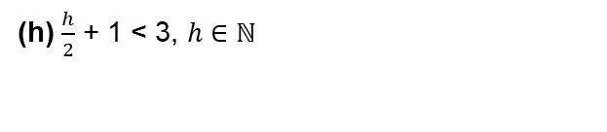
6.3 Solving and graphing inequalities – Exercise 6.3
Level 3
Find the range of values for each of the following and graph your solution on a number line.
(h) $\frac{h}{2}$ + 1 < 3, ℎ ∈ ℕ

Slide 99
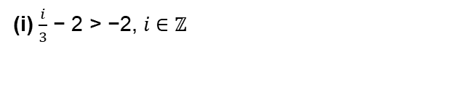
6.3 Solving and graphing inequalities – Exercise 6.3
Level 3
Find the range of values for each of the following and graph your solution on a number line.
(i) $\frac{i}{3}$ − 2 > −2, 𝑖 ∈ ℤ

Slide 100
6.3 Solving and graphing inequalities – Exercise 6.3
Level 3
Find the range of values for each of the following and graph your solution on a number line.
(j) −𝑗 + 2 > 3, 𝑗 ∈ ℤ

Slide 101
6.3 Solving and graphing inequalities – Exercise 6.3
Level 3
Find the range of values for each of the following and graph your solution on a number line.
(k) −𝑘 + 1 ≥ 3, 𝑘 ∈ ℝ

Slide 102
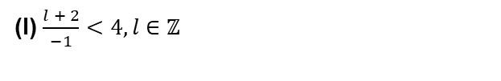
6.3 Solving and graphing inequalities – Exercise 6.3
Level 3
Find the range of values for each of the following and graph your solution on a number line.
(l) $\frac{l + 2}{−1}<4,\text{l}\text{​ ∈ }\text{ℤ}$

Slide 103
Bonus Level
6.3 Solving and graphing inequalities – Exercise 6.3
Two of the inequalities in each row can be represented by the same graph. Solve the inequalities and
identify the odd one out in each row.
(a) 2𝑥 + 3 > 5, 𝑥 ∈ ℝ 2𝑥 − 3 > 3, 𝑥 ∈ ℝ 3𝑥 − 1 > 2, 𝑥 ∈ ℝ

Slide 104
Bonus Level
6.3 Solving and graphing inequalities – Exercise 6.3
Two of the inequalities in each row can be represented by the same graph. Solve the inequalities and
identify the odd one out in each row.
(b) 4𝑥 + 2 ≤ 6, 𝑥 ∈ ℕ 2𝑥 − 1 < 5, 𝑥 ∈ ℕ 5𝑥 − 3 ≤ 2, 𝑥 ∈ ℕ

Slide 105
Bonus Level
6.3 Solving and graphing inequalities – Exercise 6.3
Two of the inequalities in each row can be represented by the same graph. Solve the inequalities and
identify the odd one out in each row.
(c) −2𝑥 + 5 ≤ 7, 𝑥 ∈ ℤ −3𝑥 + 5 < 11, 𝑥 ∈ ℤ −𝑥 + 2 ≤ 3, 𝑥 ∈ ℤ

Slide 106
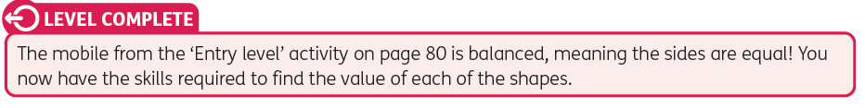

Slide 107
Revision Blaster
Level 1
1. Solve each of the following equations.
(a) 𝑥 + 3 = 6 (b) 𝑥 + 2 = 10 (c) 𝑥 + 5 = − 4

Slide 108
Revision Blaster
Level 1
1. Solve each of the following equations.
(d) 𝑥 − 1 = 11 (e) 𝑥 − 3 = 7 (f) 𝑥 − 9 = − 2

Slide 109
Revision Blaster
Level 1
1. Solve each of the following equations.
(g) 2 = 1 + 𝑥 (h) 3 = 𝑥 − 2 (i) 5 = 𝑥 − 3

Slide 110
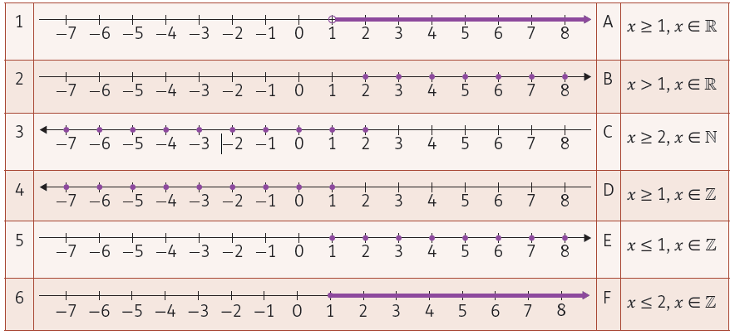
Revision Blaster
Level 1
2. Match the inequalities to the correct graph.
1 = ___ 2 = ___ 3 = ___ 4 = ___ 5 = ___ 6 = ___

Slide 111
Revision Blaster
Level 1
3. Graph the following inequalities.
𝑥 > 2, 𝑥 ∈ ℤ
(b) 𝑥 ≤ 4, 𝑥​​ ∈ ℕ
(c) 𝑥 ≥ 0, 𝑥 ∈ ℝ
(d) 𝑥 < 5, 𝑥 ∈ ℝ

Slide 112
Revision Blaster
Level 1
4. Solve and graph the following inequalities.
(a) 𝑥 + 1 ≥ 2, 𝑥 ∈ ℝ

Slide 113
Revision Blaster
Level 1
4. Solve and graph the following inequalities.
(b) 𝑥​ + 3 < 8, 𝑥​ ∈ ℕ

Slide 114
Revision Blaster
Level 1
4. Solve and graph the following inequalities.
(c) 𝑥 + 3 ≤ 1, 𝑥 ∈ ℤ

Slide 115
Revision Blaster
Level 1
4. Solve and graph the following inequalities.
(d) 𝑥 − 2 ≤ 0, 𝑥 ∈ ℤ

Slide 116
Revision Blaster
Level 1
4. Solve and graph the following inequalities.
(e) 𝑥​ − 5 > −3, 𝑥​ ∈ ℕ

Slide 117
Revision Blaster
Level 1
4. Solve and graph the following inequalities.
(f) 𝑥 − 3 < −3, 𝑥 ∈ ℝ

Slide 118
Revision Blaster
Level 2
Solve the equations.
(a) 4𝑥 = 8 (b) 3𝑥 = −9 (c) −2𝑥 = 10

Slide 119
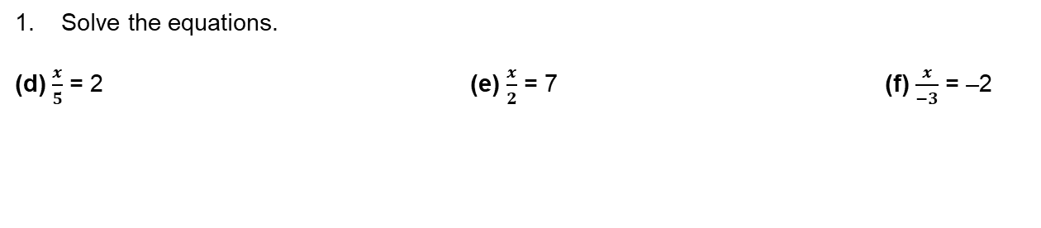
Revision Blaster
Level 2
Solve the equations.
(d) $\frac{x}{5}$ = 2 (e) $\frac{x}{2}$ = 7 (f) $\frac{x}{−3}$ = –2

Slide 120

Revision Blaster
Level 2
2. Spot the mistake and rewrite the correct solution into your copy.
(a) Solve the inequality and graph the solution:
𝑥 + 4 ≥ 1, 𝑥 ∈ ℤ
𝑥 + 4 ≥ 1
−4 −4
𝑥 ≥ −3

Slide 121

Revision Blaster
Level 2
2. Spot the mistake and rewrite the correct solution into your copy.
(b) Solve the inequality and graph the solution:
−𝑥 + 5 ≥ 0, 𝑥 ∈ ℕ
−𝑥 + 5 ≥ 0
−5 −5
− 𝑥 ≥ − 5
÷(−1) ÷(−1)
𝑥 ≥ 5

Slide 122
Revision Blaster
Level 2
3. Solve each of the following inequalities and graph the solution on a number line.
(a) −𝑥 < 3, 𝑥 ∈ ℝ

Slide 123
Revision Blaster
Level 2
3. Solve each of the following inequalities and graph the solution on a number line.
(b) 2𝑥 > 8, 𝑥 ∈ ℕ

Slide 124
Revision Blaster
Level 2
3. Solve each of the following inequalities and graph the solution on a number line.
(c) −3𝑥 ≥ 6, 𝑥 ∈ ℤ

Slide 125
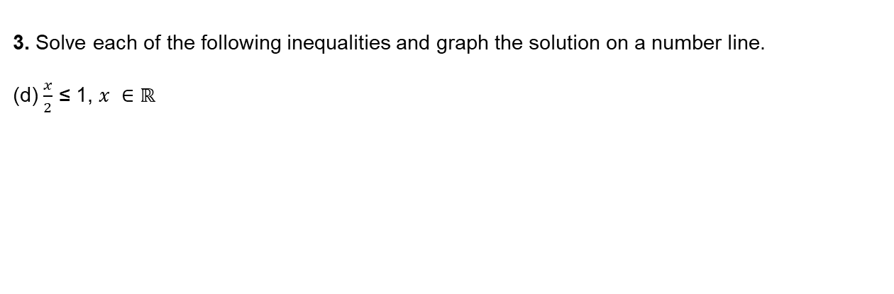
Revision Blaster
Level 2
3. Solve each of the following inequalities and graph the solution on a number line.
(d) $\frac{x}{2}$ ≤ 1, 𝑥 ∈ ℝ

Slide 126
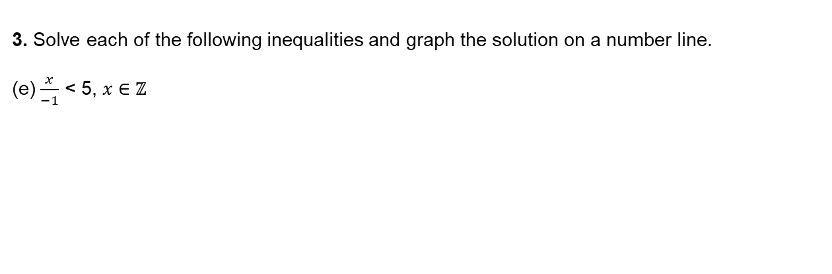
Revision Blaster
Level 2
3. Solve each of the following inequalities and graph the solution on a number line.
(e) $\frac{x}{−1}$ < 5, 𝑥 ∈ ℤ

Slide 127
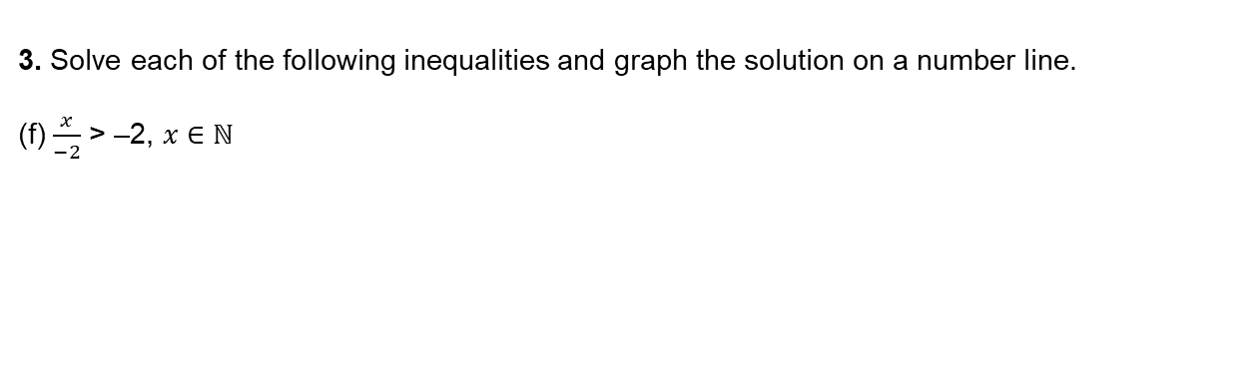
Revision Blaster
Level 2
3. Solve each of the following inequalities and graph the solution on a number line.
(f) $\frac{x}{−2}$ > –2, 𝑥 ∈ ℕ

Slide 128
Revision Blaster
Level 3
1. Solve the equations.
(a) 2𝑎 + 1 = 7 (b) 3𝑏 − 2 = 1 (c) 1 − 2𝑐 = 3

Slide 129
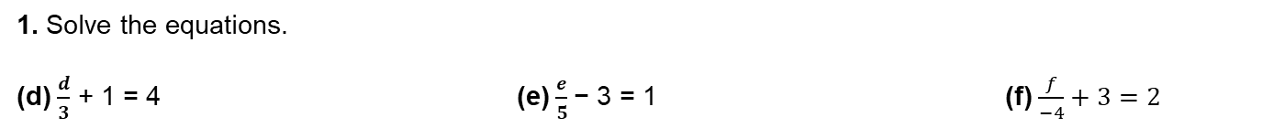
Revision Blaster
Level 3
1. Solve the equations.
(d) $\frac{d}{3}$ + 1 = 4 (e) $\frac{e}{5}$− 3 = 1 (f) $\frac{f}{−4}+3=2$

Slide 130

Revision Blaster
Level 3
2. Write down an inequality in 𝑥 represented by each of the number lines below. Put a tick (✓) in the correct box in each case to show whether 𝑥 ∈ ℕ, 𝑥 ∈ ℤ or 𝑥 ∈ ℝ (note that 𝑥 may belong to more than one set). The first one has been done for you.

Slide 131


Revision Blaster
Level 3
3. (a) Complete the inequality in 𝑛 below so that it has the solution set shown.
(b) Complete the inequality in 𝑥 below so that there is only one possible value of 𝑥, where 𝑥 ∈ ℕ.

Slide 132
Revision Blaster
Level 3
4. Solve and graph each of the following.
(a) −7 + 2𝑥 ≤ 1, where 𝑥 ∈ ℤ

Slide 133
Revision Blaster
Level 3
4. Solve and graph each of the following.
(b) 3𝑥 − 5 ≥ −2, 𝑥 ∈ ℕ

Slide 134
Revision Blaster
Level 3
4. Solve and graph each of the following.
(c) −2𝑥 + 1 > −7, 𝑥 ∈ ℕ

Slide 135

Revision Blaster
Level 3
4. Solve and graph each of the following.
(d) $\frac{x}{3}$ − 1 > 4, 𝑥 ∈ ℝ

Slide 136

Revision Blaster
Level 3
4. Solve and graph each of the following.
(e) $\frac{x}{−1}$ + 2 ≤ 5, 𝑥 ∈ ℝ

Slide 137
Revision Blaster
Level 3
4. Solve and graph each of the following.
(f) 3𝑥 − 2 ≤ 4, 𝑥 ∈ ℤ

