Slide 1
Chapter 7: Fractions, Decimals and Percentages

Slide 2
Chapter 7 content
Learning Outcomes: U.3, U.6, N.1b, N.1e, N.2a
This chapter is made up of the following lessons:
7.1 Working with fractions
7.2 Working with decimals
7.3 Working with percentages
Revision blaster
In this chapter you will:
identify fractions of amounts
find equivalent fractions
write fractions in their simplest form
calculate with decimals
write a number as a percentage of another
find a percentage of a number
convert between fractions, decimals and percentages.

Slide 3
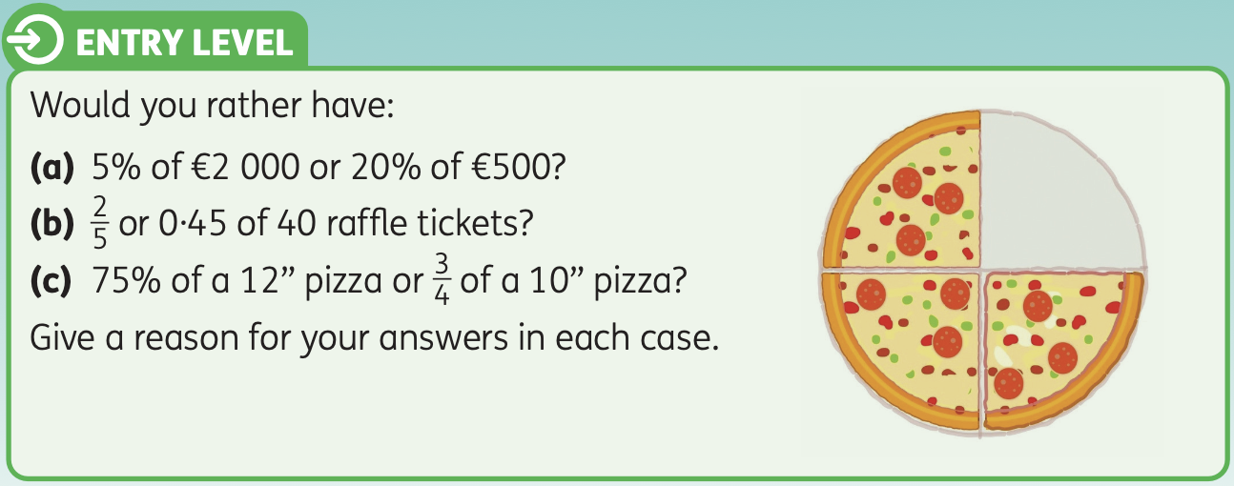

Slide 4
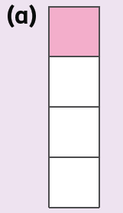
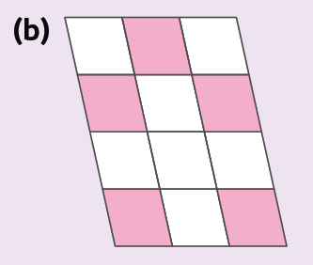
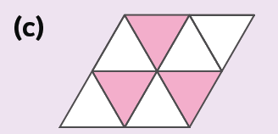
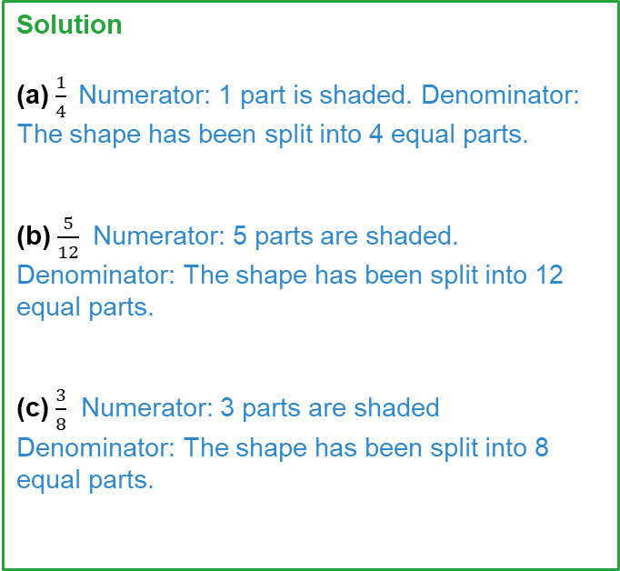
7.1 Working with fractions
Example 7.1.1
What fraction of the following shapes is shaded?
Solution
(a) $\frac{1}{4}$Numerator: 1 part is shaded. Denominator: The shape has been split into 4 equal parts.
(b) $\frac{5}{12}$ Numerator: 5 parts are shaded. Denominator: The shape has been split into 12 equal parts.
(c) $\frac{3}{8}$ Numerator: 3 parts are shaded Denominator: The shape has been split into 8 equal parts.

Slide 5
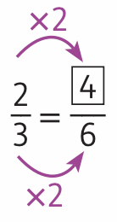
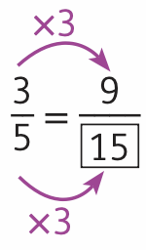
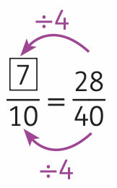
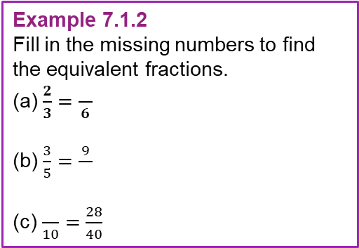
7.1 Working with fractions
Example 7.1.2
Fill in the missing numbers to find the equivalent fractions.
(a) $\frac{2}{3}=\frac{}{6}$
(b) $\frac{3}{5}=\frac{9}{}$
(c) $\frac{}{10}=\frac{28}{40}$
Solution
(a)
(b)
(c)
Numerators and denominators are multiplied or divided by the same number.

Slide 6
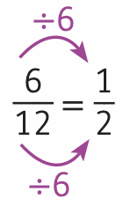
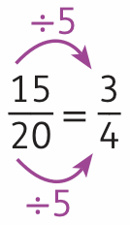
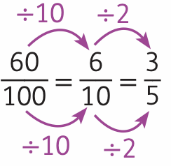
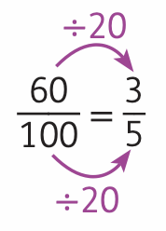
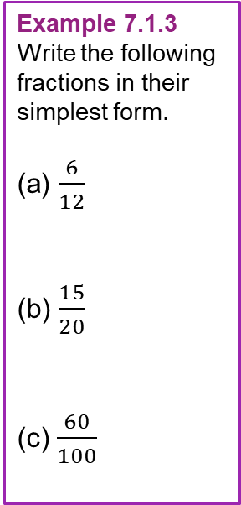
7.1 Working with fractions
Example 7.1.3
Write the following fractions in their simplest form.
(a) $\frac{6}{12}$
(b) $\frac{15}{20}$
(c) $\frac{60}{100}$
Solution
(a) HCF = 6
(b) HCF = 5
(c)
Find the HCF of 6 and 12.
Divide both numerator and denominator by the HCF.
Find the HCF of 15 and 20.
Divide both numerator and denominator by the HCF.
Sometimes it can be harder to spot the HCF. It can be useful to begin with any common factor and continue dividing the numerator and denominator by these common factors until you have simplified fully.
This gives the same result as dividing by the HCF, which is 20.
Notes:
3

Slide 7
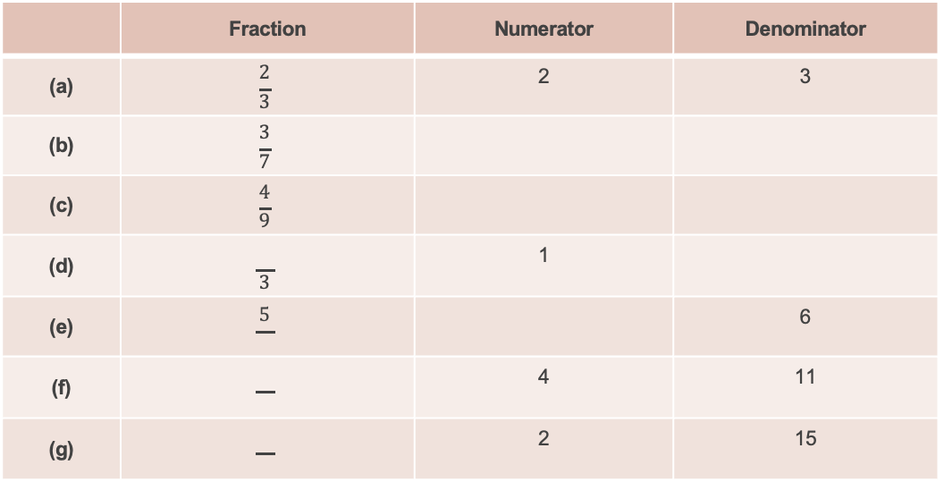
7.1 Working with fractions – Exercise 7.1
Level 1
1. Fill in the blanks to complete the table. The first one has been done for you.
 | Fraction | Numerator | Denominator
(a) | $$\frac{2}{3}$$ | 2 | 3
(b) | $$\frac{3}{7}$$
(c) | $$\frac{4}{9}$$
(d) | $$\frac{}{3}$$ | 1
(e) | $$\frac{5}{}$$ |  | 6
(f) |  | 4 | 11
(g) |  | 2 | 15

Slide 8
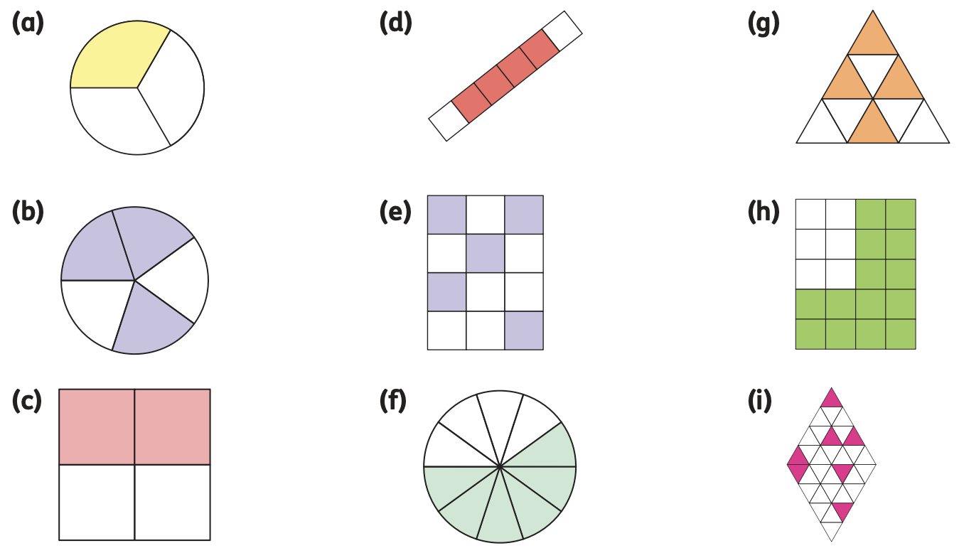
7.1 Working with fractions – Exercise 7.1
Level 1
2. What fraction of each shape is shaded?

Slide 9
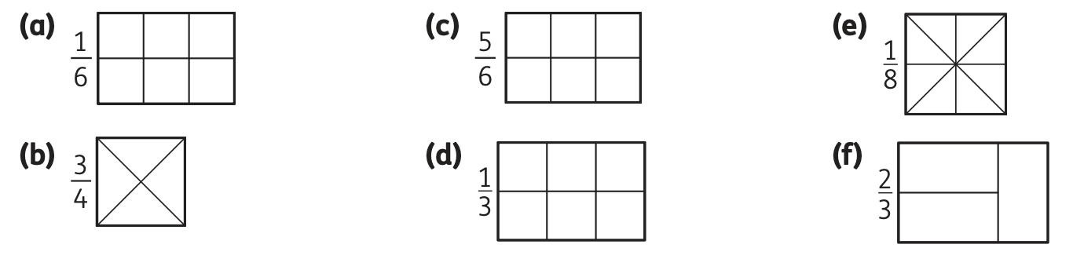
7.1 Working with fractions – Exercise 7.1
Level 1
3. Copy and shade in the given fraction of each shape.

Slide 10
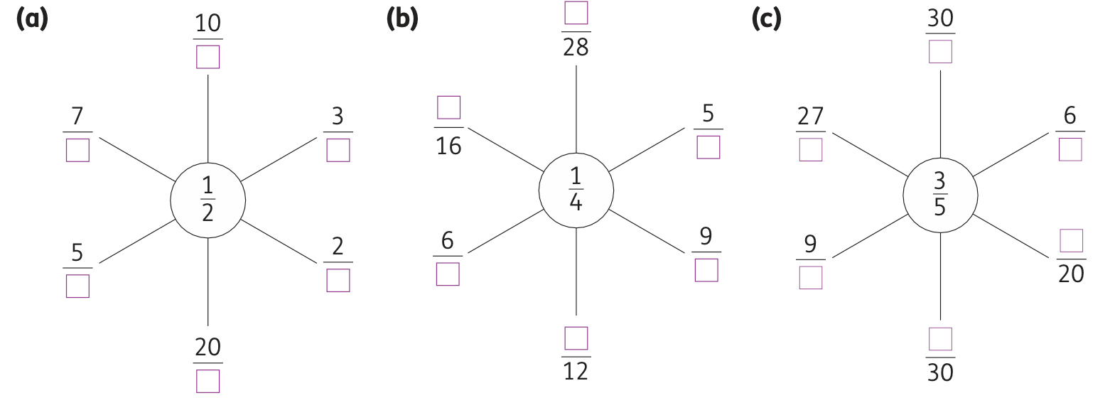
7.1 Working with fractions – Exercise 7.1
Level 1
4. Copy and complete the spider diagrams below, filling in the missing numbers to find equivalent fractions to the fraction in the middle.

Slide 11
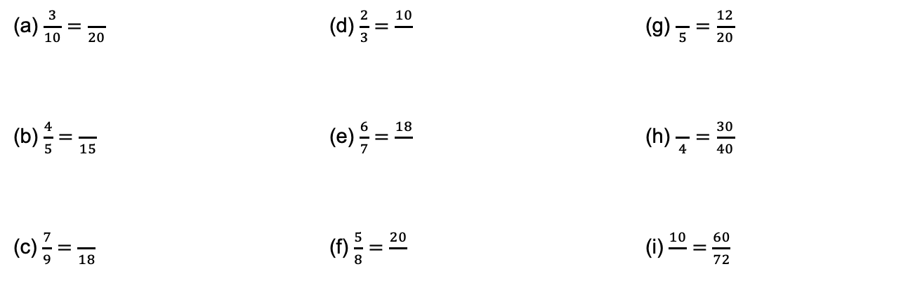
7.1 Working with fractions – Exercise 7.1
Level 1
5. Fill in the gaps to find pairs of equivalent fractions.
(a) $\frac{3}{10}=\frac{}{20}$ (d) $\frac{2}{3}=\frac{10}{}$ (g) $\frac{}{5}=\frac{12}{20}$
(b) $\frac{4}{5}=\frac{}{15}$ (e) $\frac{6}{7}=\frac{18}{}$ (h) $\frac{}{4}=\frac{30}{40}$
(c) $\frac{7}{9}=\frac{}{18}$ (f) $\frac{5}{8}=\frac{20}{}$ (i) $\frac{10}{}=\frac{60}{72}$

Slide 12
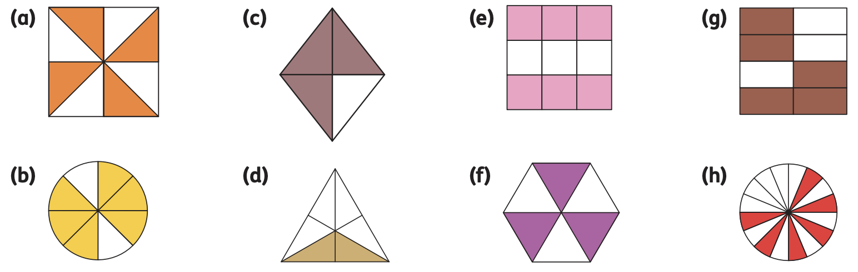
7.1 Working with fractions – Exercise 7.1
Level 2
1. What fraction of each shape is shaded? Can you find any equivalent pairs?

Slide 13
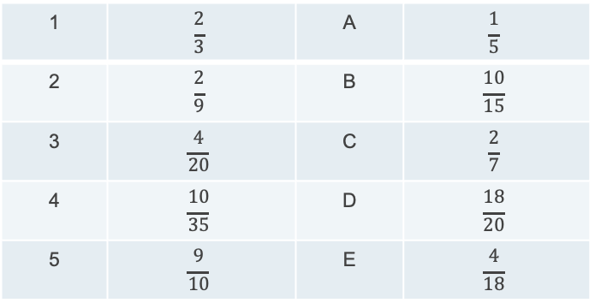
7.1 Working with fractions – Exercise 7.1
Level 2
2. Match the equivalent fractions in the table below.
1 | $$\frac{2}{3}$$ | A | $$\frac{1}{5}$$
2 | $$\frac{2}{9}$$ | B | $$\frac{10}{15}$$
3 | $$\frac{4}{20}$$ | C | $$\frac{2}{7}$$
4 | $$\frac{10}{35}$$ | D | $$\frac{18}{20}$$
5 | $$\frac{9}{10}$$ | E | $$\frac{4}{18}$$
1 = ___ 2 = ___ 3 = ___ 4 = ___ 5 = ___

Slide 14

7.1 Working with fractions – Exercise 7.1
Level 2
3. Write each fraction in its simplest form.
$\frac{18}{20}$ (e) $\frac{48}{72}$
$\frac{45}{54}$ (f) $\frac{90}{120}$
$\frac{30}{60}$ (g) $\frac{150}{450}$
$\frac{27}{63}$ (h) $\frac{1 200}{3 600}$

Slide 15
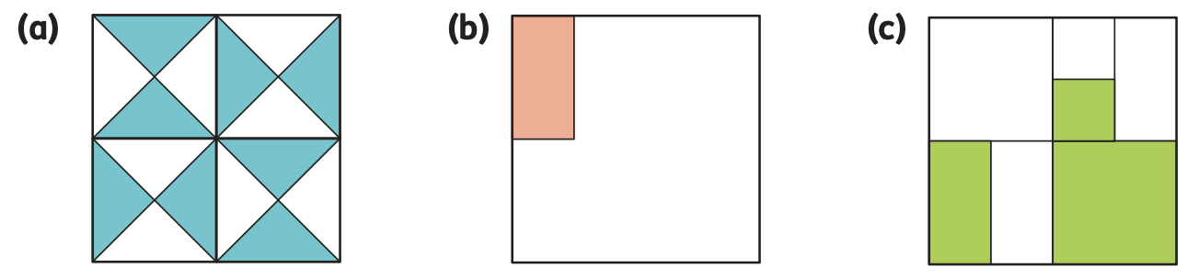
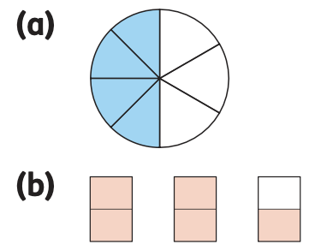
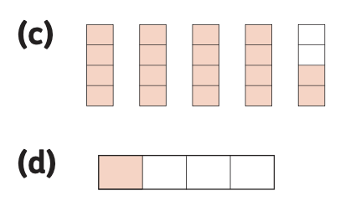




7.1 Working with fractions – Exercise 7.1
Level 3
1. What fraction of each shape is shaded? Give your answer in its simplest form.
2. Decide whether the following are true or false. Give a reason for your answer.
The shaded area = $\frac{4}{7}$
The shaded area = 4 $\frac{1}{2}$
The shaded area = $\frac{5}{6}$
The shaded area = $\frac{1}{3}$

Slide 16
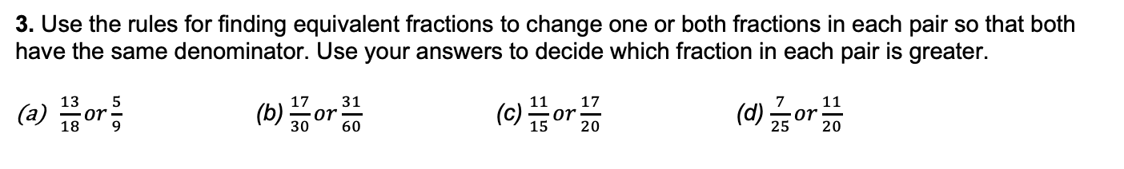
7.1 Working with fractions – Exercise 7.1
Level 3
3. Use the rules for finding equivalent fractions to change one or both fractions in each pair so that both
have the same denominator. Use your answers to decide which fraction in each pair is greater.
$\frac{13}{18}or\frac{5}{9}$ (b) $\frac{17}{30}or\frac{31}{60}$ (c) $\frac{11}{15}or\frac{17}{20}$ (d) $\frac{7}{25}or\frac{11}{20}$
4. Alisha scored 17 out of 20 on her Science test, while Calvin scored 43 out of 50 on his History exam. Who achieved the greater mark on their test? Explain your reasoning.
5. Which is the largest of the fractions $\frac{7}{15}$, $\frac{4}{9}$ and $\frac{5}{11}$? Explain your reasoning

Slide 17
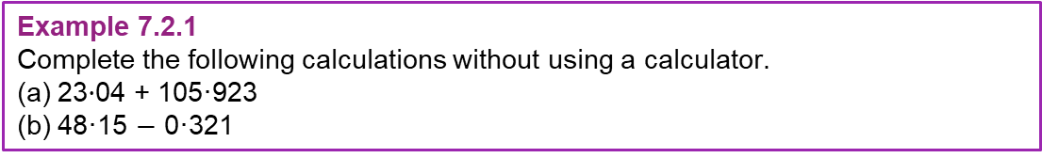
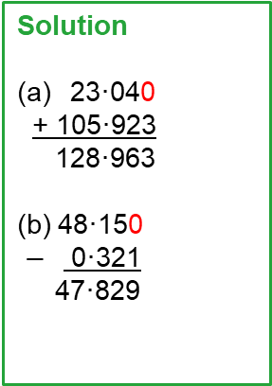
7.2 Working with decimals
Example 7.2.1
Complete the following calculations without using a calculator.
(a) 23$·$04 + 105·923
(b) 48·15 $−$ 0·321
Solution
    23·040
+ 105·923
128·963
(b) 48·150
$−$ 0·321
47·829
It is very important that you carefully consider place value when adding and subtracting decimals:
• Use the decimal point to help you to line up the numbers correctly.
• Add placeholder 0s if needed at the end of numbers to help with your calculation.
• Complete the addition or subtraction as normal.

Slide 18
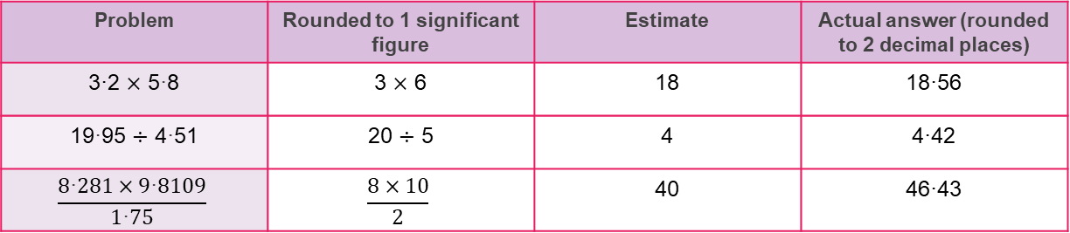
7.2 Working with decimals
Example 7.2.2
Complete the table below using your calculator.
Solution
Problem | Rounded to 1 significant figure | Estimate | Actual answer (rounded to 2 decimal places)
3·2 $×$ 5·8 | 3 $×$ 6 | 18 | 18·56
19·95 $÷$ 4·51 | 20 $÷$ 5 | 4 | 4·42
$$\frac{8\text{·}281×9\text{·}8109}{1\text{·}75}$$ | $$\frac{8×10}{2}$$ | 40 | 46·43
Notes:
3

Slide 19
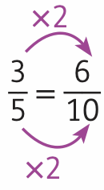
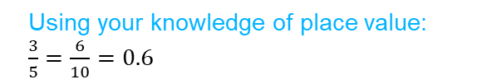

7.2 Working with decimals
Example 7.2.3
Write $\frac{3}{5}$ as a decimal.
Solution
Without a calculator
(a) We need to find an equivalent fraction with a denominator of 10, 100 or 1 000 to allow for easy conversion to decimals using the place value grid.
With a calculator
(a) Remember $\frac{3}{5}$ means $3÷5$. Simply type $3÷5$ into your calculator and use the conversion button to show that:
the place value grid.
$\frac{3}{5}=0\text{·}6$
Using your knowledge of place value:
$\frac{3}{5}=\frac{6}{10}=0.6$
Notes:
3

Slide 20
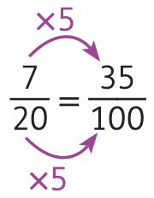
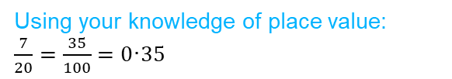
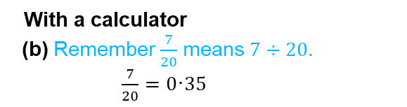
7.2 Working with decimals
Example 7.2.3
(b) Write $\frac{7}{20}$ as a decimal.
Solution
Without a calculator
(b) We need to ensure the denominator Is a multiple of 100.
With a calculator
(b) Remember $\frac{7}{20}$ means $7÷20$.
$\frac{7}{20}=0\text{·}35$
Using your knowledge of place value:
$\frac{7}{20}=\frac{35}{100}=0\text{·}35$
Notes:
3

Slide 21

7.2 Working with decimals
Example 7.2.3
(c) Write $\frac{5}{11}$ as a decimal.
Solution
Without a calculator
(c) As 11 is not a factor of 10, 100 or
1 000, we will need to use a calculator for this example.
With a calculator
(c) Type $5÷11$ into your calculator and use the conversion button to convert to a decimal.
$\frac{5}{11}=0\text{·}45$
Notes:
3

Slide 22
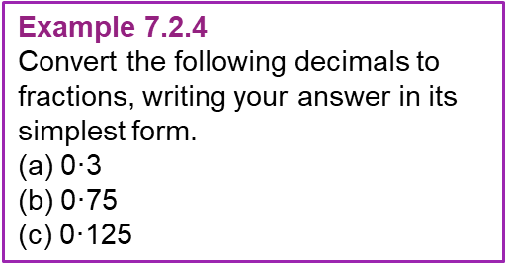

7.2 Working with decimals
Example 7.2.4
Convert the following decimals to fractions, writing your answer in its simplest form.
(a) 0$\text{·}$3
(b) 0$\text{·}$75
(c) 0$\text{·}$125
Solution
(a) The last digit (3) is in the tenths place:
$0\text{·}3=\frac{3}{10}$
(b) The last digit (5) is in the hundredths place:
$0\text{·}75=\frac{75}{100}=\frac{3}{4}$
(c) The last digit (5) is in the thousandths place:
$0\text{·}125=\frac{125}{1 000}=\frac{1}{8}$
Notes:
3

Slide 23
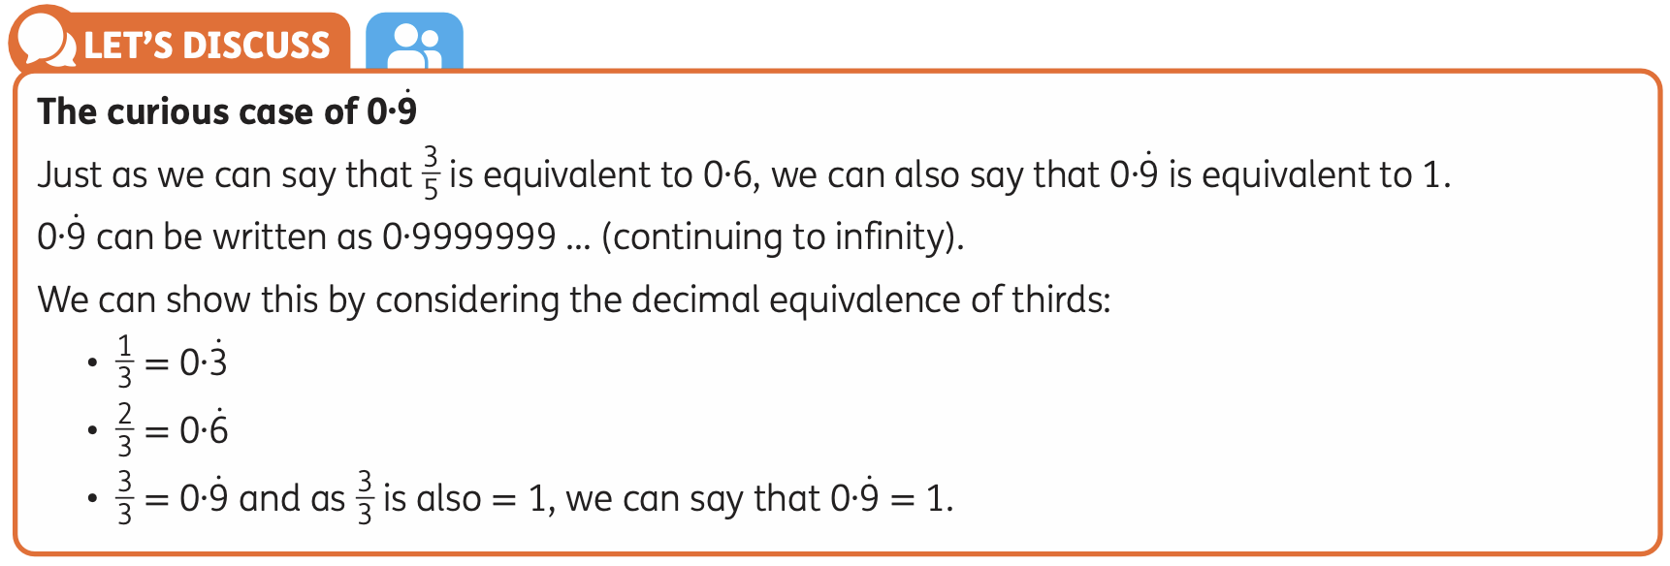
7.2 Working with decimals

Slide 24
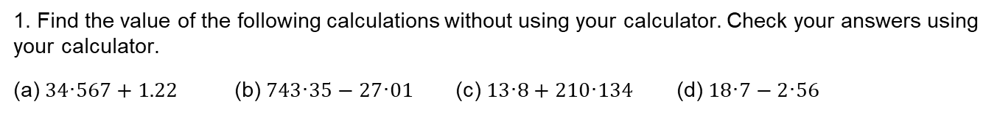
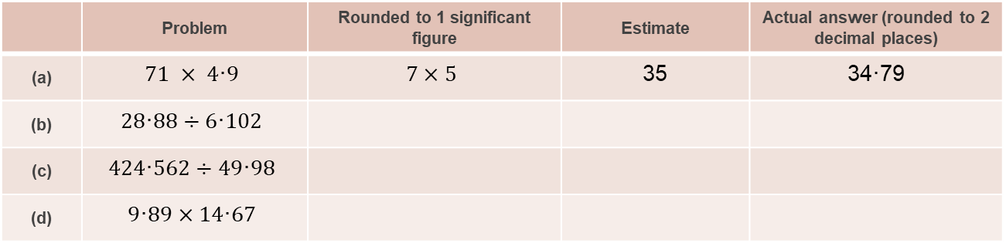
7.2 Working with decimals – Exercise 7.2
Level 1
1. Find the value of the following calculations without using your calculator. Check your answers using your calculator.
(a) $34\text{·}567+1.22$ (b) $743\text{·}35−27\text{·}01$ (c) $13\text{·}8+210\text{·}134$ (d) $18\text{·}7−2\text{·}56$
2. Complete the table below. First estimate your answers, then use your calculator to find the solution. The first one has been done for you.
 | Problem | Rounded to 1 significant figure | Estimate | Actual answer (rounded to 2 decimal places)
(a) | $$71 × 4\text{·}9$$ | $$7×5$$ | 35 | 34$\text{·}$79
(b) | $$28\text{·}88÷6\text{·}102$$
(c) | $$424\text{·}562÷49\text{·}98$$
(d) | $$9\text{·}89×14\text{·}67$$

Slide 25
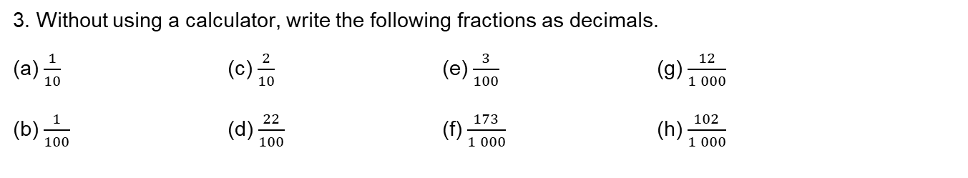
7.2 Working with decimals – Exercise 7.2
Level 1
3. Without using a calculator, write the following fractions as decimals.
(a) $\frac{1}{10}$ (c) $\frac{2}{10}$ (e) $\frac{3}{100}$ (g) $\frac{12}{1 000}$
(b) $\frac{1}{100}$ (d) $\frac{22}{100}$ (f) $\frac{173}{1 000}$ (h) $\frac{102}{1 000}$
4. Without using a calculator, write the following decimals as fractions and simplify your answer.
(a) $0\text{·}2$ (c) $0\text{·}8$ (e) $0\text{·}25$
(b) $0\text{·}6$ (d) $0\text{·}5$ (f) $0\text{·}75$
5. Use dot notation to rewrite the following recurring decimals.
(a) 0∙22222222222 ... (c) 0∙42424242424 ... (e) 0∙421212121212 ...
(b) 0∙44444444444 ... (d) 0∙421421421421 ...

Slide 26
7.2 Working with decimals – Exercise 7.2
Level 2
1. At a café you and three friends buy three scones for €2∙25 each, a croissant for €2∙85 and four hot chocolates for €3∙78 each. You decide to split the bill equally between the four of you.
(a) Estimate how much each person will pay by rounding the price of each item to 1 significant figure. Do this without your calculator.
(b) Find the actual amount owed by each person using your calculator.
2. John ran a quarter mile race in 74∙5 seconds. Mark said he ran the same race in 82∙34 seconds. How many seconds faster was John than Mark?
(a) Estimate your answer by rounding the times to 2 significant figures.
(b) Find the actual difference in times without using a calculator.
(c) Use your calculator to check your answer and find the difference between your estimate and the actual answer.

Slide 27
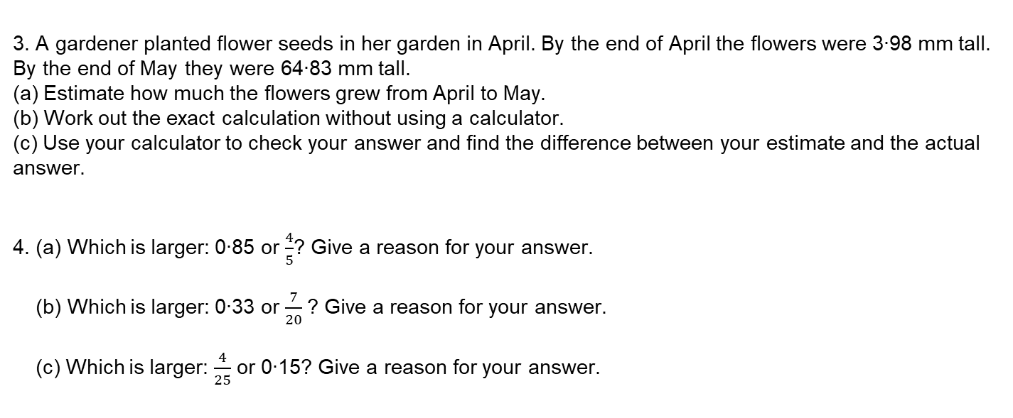
7.2 Working with decimals – Exercise 7.2
Level 2
3. A gardener planted flower seeds in her garden in April. By the end of April the flowers were 3∙98 mm tall. By the end of May they were 64∙83 mm tall.
(a) Estimate how much the flowers grew from April to May.
(b) Work out the exact calculation without using a calculator.
(c) Use your calculator to check your answer and find the difference between your estimate and the actual answer.
4. (a) Which is larger: 0∙85 or $\frac{4}{5}$? Give a reason for your answer.
(b) Which is larger: 0∙33 or $\frac{7}{20}$? Give a reason for your answer.
(c) Which is larger: $\frac{4}{25}$ or 0∙15? Give a reason for your answer.

Slide 28
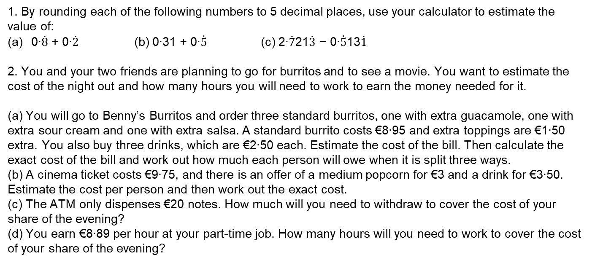
7.2 Working with decimals – Exercise 7.2
Level 3
1. By rounding each of the following numbers to 5 decimal places, use your calculator to estimate the
value of:
0∙$\dot{8}$ + 0∙$\dot{2}$ (b) 0∙31 + 0∙$\dot{5}$ (c) 2∙$\dot{7}$21$\dot{3}$ − 0∙$\dot{5}$13$\dot{1}$
2. You and your two friends are planning to go for burritos and to see a movie. You want to estimate the cost of the night out and how many hours you will need to work to earn the money needed for it.
(a) You will go to Benny’s Burritos and order three standard burritos, one with extra guacamole, one with extra sour cream and one with extra salsa. A standard burrito costs €8∙95 and extra toppings are €1∙50 extra. You also buy three drinks, which are €2∙50 each. Estimate the cost of the bill. Then calculate the exact cost of the bill and work out how much each person will owe when it is split three ways.
(b) A cinema ticket costs €9∙75, and there is an offer of a medium popcorn for €3 and a drink for €3∙50. Estimate the cost per person and then work out the exact cost.
(c) The ATM only dispenses €20 notes. How much will you need to withdraw to cover the cost of your share of the evening?
(d) You earn €8∙89 per hour at your part-time job. How many hours will you need to work to cover the cost of your share of the evening?

Slide 29

7.2 Working with decimals – Exercise 7.2
Bonus level
Place all the digits 1, 2, 3, 4, 5, 6 in the sum below, using each digit exactly once, to get the following answers:
(a) 7∙05 (b) 10∙02 (c) 11∙91 (d) 13∙44

Slide 30
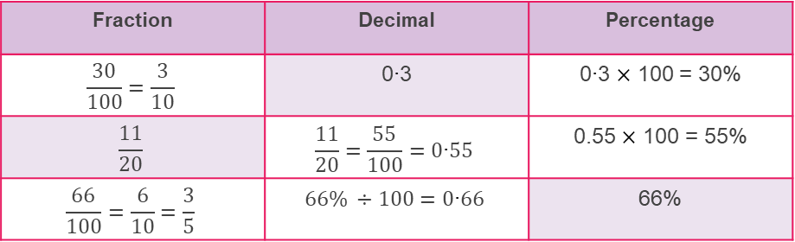
7.3 Working with percentages
Example 7.3.1
Complete the table showing the fraction, decimal, percentage equivalence
Solution
Fraction | Decimal | Percentage
$$\frac{30}{100}=\frac{3}{10}$$ | 0∙3 | 0∙3 $×$ 100 = 30%
$$\frac{11}{20}$$ | $$\frac{11}{20}=\frac{55}{100}=0\text{∙}55$$ | 0.55 $×$ 100 = 55%
$$\frac{66}{100}=\frac{6}{10}=\frac{3}{5}$$ | $$66\% ÷100=0\text{∙}66$$ | 66%
Notes:
3

Slide 31
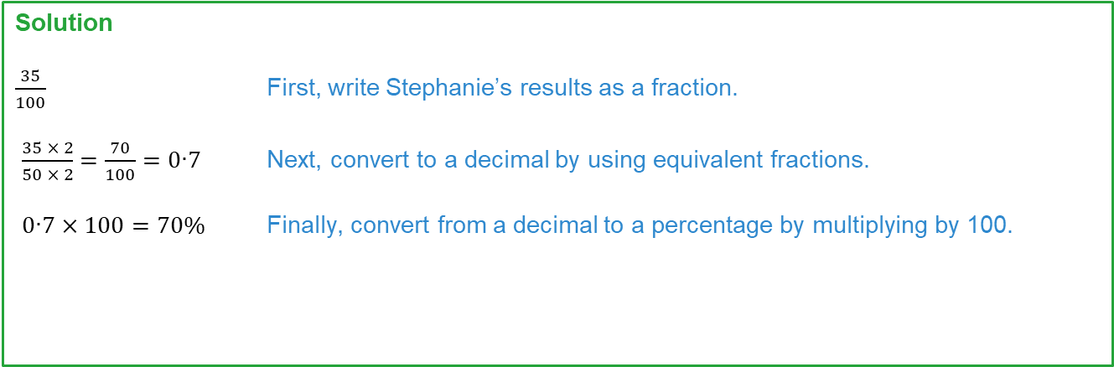
7.3 Working with percentages
Example 7.3.2
Stephanie scored 35 out of 50 on her French vocabulary test. Write her result as a percentage.
Solution
$\frac{35}{100}$ First, write Stephanie’s results as a fraction.
$\frac{35 × 2}{50 × 2}=\frac{70}{100}=0\text{∙}7$ Next, convert to a decimal by using equivalent fractions.
$0\text{∙}7×100=70\%$ Finally, convert from a decimal to a percentage by multiplying by 100.
Notes:
3

Slide 32
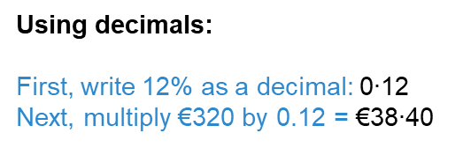

7.3 Working with percentages
Example 7.3.3
Find 12% of €320.
Solution
Using decimals:
First, write 12% as a decimal: 0$\text{∙}$12
Next, multiply €320 by 0.12 = €38$\text{∙}$40
Using fractions:
First, write 12% as a fraction: $\frac{12}{100}$
Next, multiply €320 by $\frac{12}{100}$ = €38$\text{∙}$40
Notes:
3

Slide 33
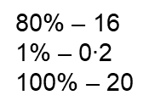
7.3 Working with percentages
Example 7.3.4
Geoff scored 80% on his Geography test. If Geoff answered 16 questions correctly, how many questions were on the test?
Solution
80% – 16
1% – 0$\text{∙}$2
100% – 20
Find 1% by dividing both sides by 80.
Find 100% by multiplying both sides by 100.
Notes:
3

Slide 34
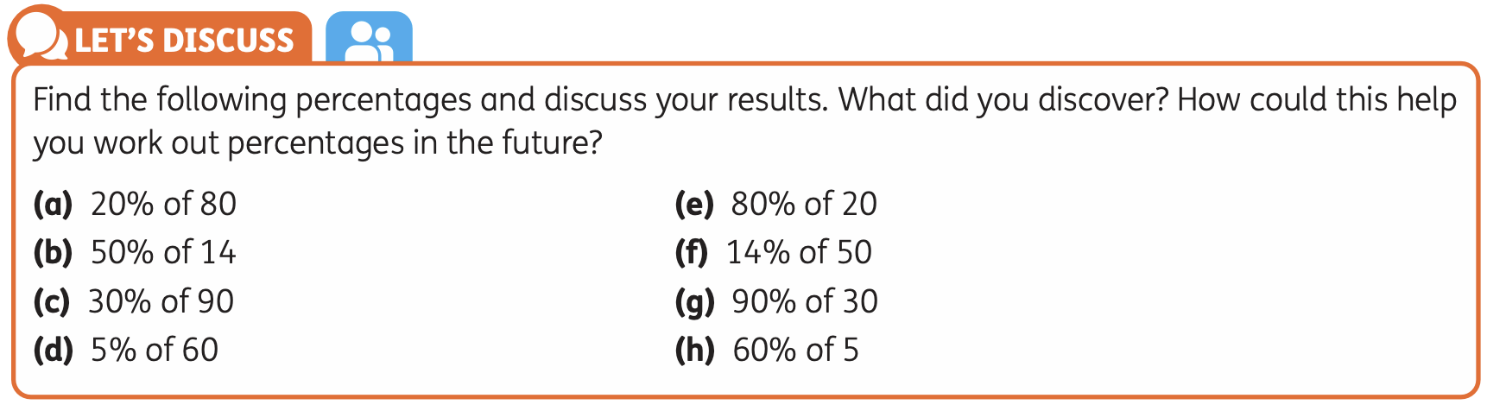
7.3 Working with percentages

Slide 35
7.3 Working with percentages – Exercise 7.3
Level 1
1. Convert each decimal to a percentage.
(a) 0∙23 (b) 0∙37 (c) 0∙78
(d) 0∙99 (e) 0∙52 (f) 0∙5
(g) 0∙3 (h) 0∙1 (i) 0∙13
(j) 0∙03 (k) 0∙02 (l) 0∙01
2. Convert each percentage to a decimal.
(a) 45% (b) 82% (c) 24%
(d) 98% (e) 60% (f) 90%
(g) 20% (h) 12% (i) 7%
(j) 6% (k) 9% (l) 5%

Slide 36

7.3 Working with percentages – Exercise 7.3
Level 1
3. Show the decimal and percentage equivalences of the following fractions.
(a) $\frac{2}{10}$ (b) $\frac{34}{100}$ (c) $\frac{6}{100}$
(d) $\frac{11}{50}$ (e) $\frac{3}{20}$ (f) $\frac{6}{25}$
(g) $\frac{1}{4}$ (h) $\frac{3}{4}$ (i) $\frac{4}{5}$
4. (a) The First Year basketball team won 16 out of 20 games in the season. Write this as a percentage.
(b) In a class of 25 students, 15 have brown hair. Write this as a percentage.
(c) Out of 30 days in September, it rained on 12 days. Write this as a percentage.
5. Calculate the value of the following. Round your answers to the nearest whole number.
(a) 10% of €700 (b) 25% of 520 kg
(c) 30% of 124 km (d) 65% of €1 020

Slide 37

7.3 Working with percentages – Exercise 7.3
Level 2
1. Identify the odd one out in each row. The first one is done for you.
(a) | 0∙4 | 40% | $$\frac{1}{4}$$
(b) | 35% | $$\frac{3}{5}$$ | 0∙6
(c) | $$\frac{1}{5}$$ | 0∙15 | 15%
(d) | 0∙9 | 9% | $$\frac{9}{10}$$
(e) | $$\frac{1}{3}$$ | 33∙3% | 0∙3

Slide 38

7.3 Working with percentages – Exercise 7.3
Level 2
2. Write each set of numbers in ascending order.
$\frac{1}{3} 0\text{∙}2 25\% \frac{3}{10}$
$0\text{∙}12 11\% \frac{2}{25} 0\text{∙}07$
$\frac{7}{20} 0\text{∙}34 \frac{1}{3}$ $\frac{8}{25}$
3. In an exam, Brody scored:
• 13 out of 25 in Section A
• 23 out of 50 in Section B.
Work out Brody’s percentage score in Section A.
Work out Brody’s percentage score in Section B.
Work out Brody’s overall score on the exam.

Slide 39

7.3 Working with percentages – Exercise 7.3
Level 2
4. Place the numbers in the correct spaces to make the statements true.

Slide 40

7.3 Working with percentages – Exercise 7.3
Level 2
5. Grace is completing her homework. Can you spot her mistakes?
Write 40% as a fraction in its simplest form:
$\frac{40}{100}=\frac{4}{10}$
(b) Write 8% as a fraction in its simplest form:
$\frac{8}{10}=\frac{4}{5}$

Slide 41


7.3 Working with percentages – Exercise 7.3
Level 3
1. Place the fractions, decimals and percentages in the grid below so that each row and column is in ascending order.
$$0\text{∙}6 \frac{3}{4} 57\% \frac{2}{3} 77\%$$
$$0\text{∙}62 65\% 0\text{∙}68 \frac{1}{2}$$

Slide 42
7.3 Working with percentages – Exercise 7.3
Level 3
2. Out of 780 students in a school:
• 12% cycle to school
• 28% walk
• 40% get dropped off via car
• the rest get the bus.
Complete the table to show the number of students who take each mode of transport. Round your answers to the nearest whole number.
Mode of transport | Number of students
Cycle
Walk
Car
Bus

Slide 43


7.3 Working with percentages – Exercise 7.3
Level 3
3. Fill in the gaps in the calculations below.
30% of 50 = ____ (c) 40% of ____ = 36 (e) ____% of 120 = 66
25% of ____ = 20 (d) 5% of ____ = 6∙25 (f) ____% of 500 = 300
4. A child’s ticket for the Natural History Museum is €15. This is 60% of the cost of an adult ticket.
Bridgid, Christopher and their three children pay for their tickets using a €100 note. How much change will they receive?
5. Place the numbers below in the correct region of the Venn diagram. Remember:
ℕ = Natural numbers ℤ = Integers ℚ = Rational numbers
$\frac{1}{2}, −4, 8, 0, 0\text{∙}2, 90\%, −0\text{∙}1, \frac{12}{6}, 3, −1$

Slide 44


Slide 45

Revision Blaster
Level 1
(a) Circle the fraction that is equivalent to $\frac{2}{3}$.
$\frac{4}{9}$ $\frac{7}{8}$ $\frac{15}{20}$ $\frac{16}{24}$
2. (a) Write 63% as a decimal.
(b) Write 82% as a fraction in its simplest form.
3. (a) Work out €5∙81 + €3∙09 without using a calculator.
(b) Work out €2 − €1∙36 without using a calculator.
4. (a) What is $\frac{9}{10}$ as a percentage? Circle your answer.
0∙09% 0∙9% 9% 90%
(b) Circle the smallest number.
$\frac{11}{20}$ $\frac{3}{10}$ $\frac{1}{5}$ $\frac{1}{4}$

Slide 46


Revision Blaster
Level 1
5. Copy the shape three times and shade in the following areas:
25% of the shape
$\frac{3}{8}$ of the shape
0∙75 of the shape

Slide 47

Revision Blaster
Level 2
(a) Circle the fraction that is not equivalent to $\frac{3}{8}$.
$\frac{6}{16}$ $\frac{9}{24}$ $\frac{12}{32}$ $\frac{15}{35}$
(b) Circle the fraction greater than $\frac{3}{10}$.
$\frac{1}{3}$ $\frac{3}{11}$ $\frac{4}{15}$ $\frac{29}{100}$
(c) Circle the two values that are equivalent to $\frac{2}{3}$.
$\frac{66}{100}$ 0∙6 60% $\frac{66}{99}$ 0∙6

Slide 48

Revision Blaster
Level 2
2. (a) Put these numbers in order starting with the smallest.
33∙3 $\frac{1}{33}$ −0∙3 3∙03
(b) Jo thinks the difference between −0∙3 and 33∙3 is 33. Is she correct?
3. For every €200 that Mrs Kerins earns, she saves €34.
Work out €34 as a percentage of €200.
(b) Last month Mrs Kerins earned €1 000. How much of this did she save?

Slide 49

Revision Blaster
Level 3
Which is the greater percentage? Put a tick (✓) in the correct box.
18 out of 40
41 out of 90
2. Using approximations to estimate the value of
$\frac{204 × 3\text{.}99}{0\text{.}112}$
You must show your working.

Slide 50

Revision Blaster
Level 3
3. A farm has a total area of 160 hectares. 62 hectares are used for growing crops.
Work out the percentage of the area of the farm that is used for growing crops.
4. 600 people visit a cinema.
$\frac{1}{4}$ go to screen 1.
40% go to screen 2.
The rest go to screen 3.
How many people go to screen 3?

