Slide 1

Strand 2 Structures and Processes of Life
Unit 11 Response
Learning Outcomes: 2.4.2, 2.4.3
Chapter 40
The musculoskeletal system
By the end of this chapter, you should be able to:
outline the functions of the musculoskeletal system
identify and relate the parts of the axial and appendicular skeleton to their functions
describe the location and function of discs in relation to vertebrae
relate the functions of cartilage, ligaments and tendons in synovial joints
model the function of an antagonistic muscle pair.
1

Slide 2
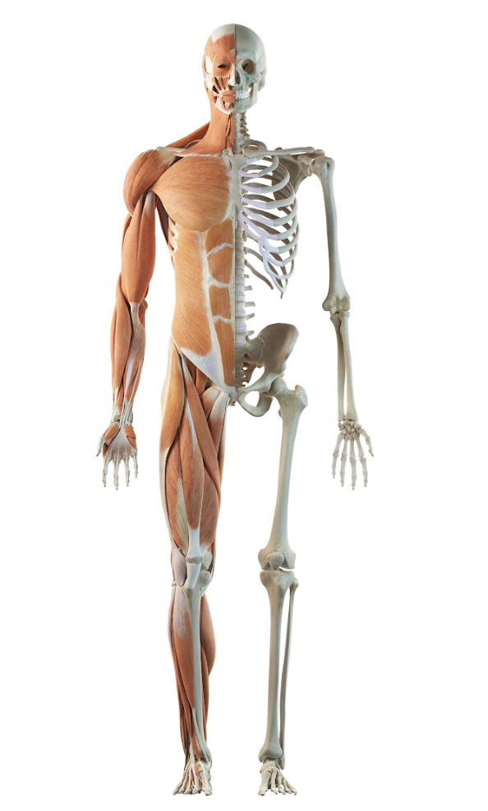
Components of the musculoskeletal system
Bones
Muscles
Joints
Connective tissue
Fig. 40.1
The human musculoskeletal system includes the skeleton, muscles
and joints

Slide 3
Functions of the musculoskeletal system
Support and stability
Protection
Movement
Production and storage of blood components
Storage of fat
Storage of minerals

Slide 4
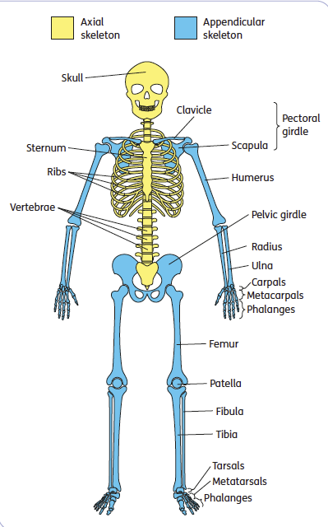
The human skeleton
Humans are born with approximately 270 bones
An adult skeleton has 206 bones
Composed of the:
  Axial skeleton: the central column of bones in the human body, including the skull, vertebrae, ribs and sternum
  Appendicular skeleton: the bones in the human body that connect to the axial skeleton, including the pectoral girdle, pelvic girdle and limbs
Fig. 40.2
Parts of the axial skeleton and appendicular skeleton

Slide 5
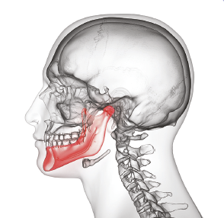
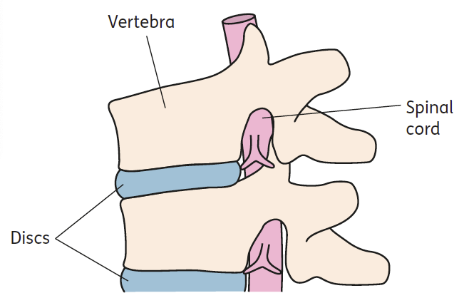
Structures and functions of the axial skeleton
Skull
  Also known as the cranium
  Composed of 22 fused bones except for the lower jaw
Vertebrae
  The vertebrae are the 33 bones that make up the spine
  Each vertebra is separated by a disc
    Discs allow movement of the spine and act as shock absorbers to protect the vertebrae
  The vertebrae and discs protect and support the spinal cord
Fig. 40.3
The lower jaw is the only bone in the skull that moves
Fig. 40.4
Position of discs in relation to vertebrae

Slide 6
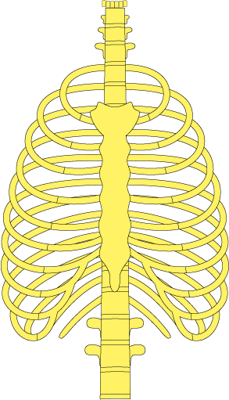
Ribs
  The ribs are connected to the vertebrae and extend around the human body
  There are 12 pairs of ribs
  Function:
    Protect the organs in the chest
    Movement during breathing aided by intercostal muscles
Sternum
  Breastbone
  Located in the middle of the chest and is connected to the clavicle, ribs and muscles
  Function:
    Protects the organs in the chest
The sternum and ribs make up the rib cage.

Slide 7
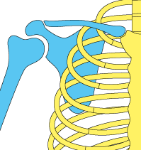
Structures and functions of the appendicular skeleton
Pectoral girdle
  The human body consists of two pectoral girdles
  Each pectoral girdle consists of the following
    Clavicle also known as collarbone which supports the upper body and connects the arm to the axial skeleton
    Scapula also known as shoulder blade which allows for movement of the arm in six directions. It also acts as a shock absorber for the upper body.

Slide 8
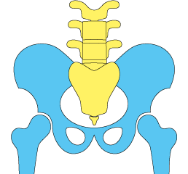
Pelvic girdle
  A ring-like structure composed of the hip bone and sacrum
  Connects the lower limbs to the vertebrae
  Function:
    Supports and transfers body weight
    Allows movement of the legs
    Protects organs
    Plays an important role in pregnancy and childbirth

Slide 9
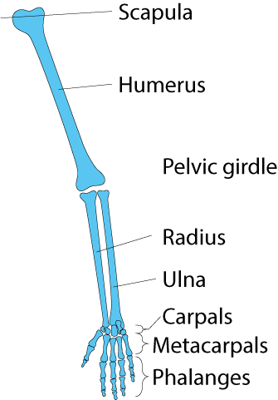
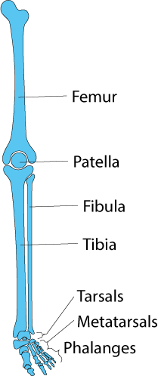
Limbs
  Arms and legs
  Each limb has several bones
  Arms
    The forearm is composed of the humerus, radius and ulna. These bones allow movement and support muscles.
    The small bones in the wrist are called carpals
    The bones in the palms of each hand are metacarpals
    The finger bones are called the phalanges
      The carpals, metacarpals and phalanges allow for finer movements such as twisting and gripping
  Legs
    The lower leg is composed of the femur, patella (kneecap), tibia and fibula. These bones provide support and stability to the body and allow movement.
    The ankle is made up of the tarsals
    The arch of the foot is composed of metatarsals
    Function of tarsals and metatarsals:
      Support body weight
      Allow foot movement
      Act as shock absorbers
    The toe bones are called phalanges, and they allow grip during movement

Slide 10
Learning check
Outline four functions of the human skeleton.
CLICK HERE FOR ANSWER
The functions of the human skeleton are:
Support and stability
Protection
Movement
Production and storage of blood components
Storage of fat
Storage of minerals

Slide 11
Learning check
What is the function of the human skeleton?
The axial skeleton is the central column of bones in the human body, including the skull, vertebrae, ribs and sternum while the appendicular skeleton is the bones in the human body that connect to the axial skeleton, such as the pectoral girdle, pelvic girdle and limbs.
What is the function of the skull?
The function of the skull is to protect the brain and give structure to the face.
Name the structure that separates each vertebra from the next and describe its function.
Discs are the structures that separate each vertebra. The function of discs is to allow movement of the spine and to act as shock absorbers to protect the vertebrae.
CLICK HERE FOR ANSWER
CLICK HERE FOR ANSWER
CLICK HERE FOR ANSWER

Slide 12
Learning check
Name the muscles found between the ribs.
The intercostal muscles are the muscles found between the ribs.
Distinguish between the pectoral girdles and the pelvic girdle with reference to their location in the body and the bones of which they are composed.
Pectoral girdles connect the upper arms to the vertebrae. They are composed of the clavicle and scapula. The pelvic girdle connects the lower limbs (legs) to the vertebrae. It is made up of the hip bones and the sacrum.
CLICK HERE FOR ANSWER
CLICK HERE FOR ANSWER

Slide 13
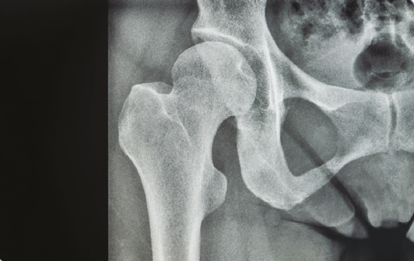
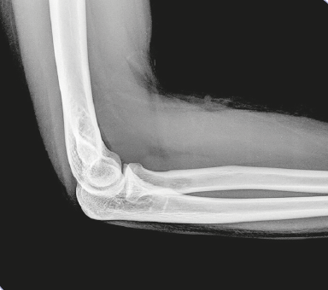
Types of joints
Joint: A place in the skeleton where two or more bones meet
Fig. 40.8
An X-ray of the hip joint
There are three types of joints in the human body:
  Immovable joints
  Slightly movable joints
  Synovial joints
Fig. 40.10
An X-ray of the elbow joint

Slide 14
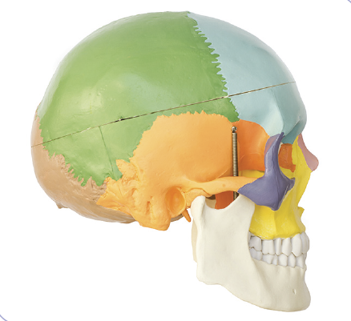
Immovable joints
Joints that are fixed or fused
No movement of bones at the joint
Function:
  Provide protection
The adult skull is made up of immovable joints called sutures, which protect the brain and give structure to the face
Fig. 40.6
A model using different colours to show where bones meet at sutures in the skull

Slide 15
Slightly movable joints
Cartilage: Connective tissue that reduces the friction between bones during movement
Allow slight movement of the bones they connect
Held together by a strong flexible tissue called cartilage
Joints between the vertebrae are slightly movable
The discs between each vertebra is cartilage
Fig. 40.4
Position of discs in relation to vertebrae

Slide 16
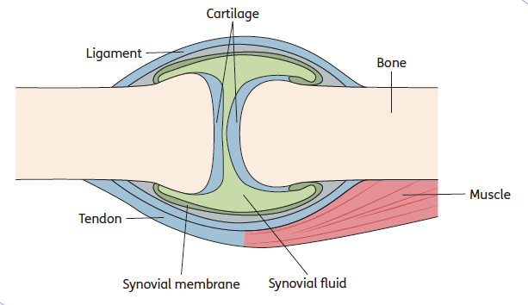
Synovial joints
Synovial joint: A freely movable joint that allows movement of the limbs
Cartilage at the end of each bone in a synovial joint protects bone and prevents friction between the bones as they move
Synovial fluid is secreted through a membrane into the space between the bones to reduce friction further by lubricating the joint.
Arthritis is caused when excess synovial fluid is produced in the joints, putting pressure on the bones, causing pain.
Fig. 40.11
A synovial joint

Slide 17
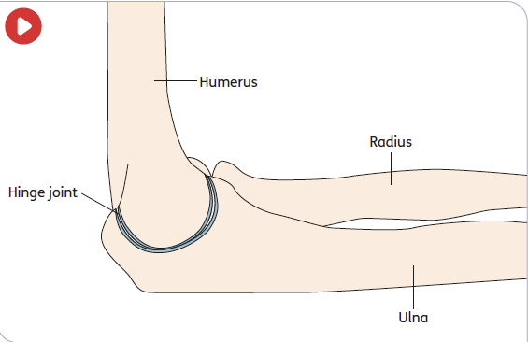
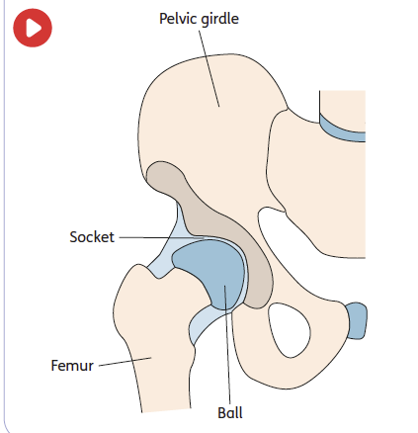
Types of synovial joints
Ball and socket joints
Allow for movement in all directions
Found in the shoulder and hip
Hinge joints
Allow movement in one direction only
Found in the knee and elbow
Fig. 40.9
The hinge joint of the elbow
Fig. 40.7
The ball and socket joint of the hip

Slide 18
Connective tissue in joints
Ligament: Connective tissue that attaches bone to bone for movement
Tendon: Connective tissue that attaches muscle to bone for movement
Elastic tissues that hold the bones together
Stretch to allow movement but prevent the joint from moving too far
Ligaments become more flexible when they are warm.
  Prevent injury by doing warm up exercises before physical activity
Strong fibrous inelastic tissue
Support and protect muscles by helping to move the limbs.
Act as shock absorbers during physical activities such as running and jumping

Slide 19
Muscles
Movement of joints is aided by muscles contracting or relaxing
Muscle contraction is tightening or shortening of the muscle for movement
Muscle relaxation is returning the muscle to normal, low-tension state.

Slide 20
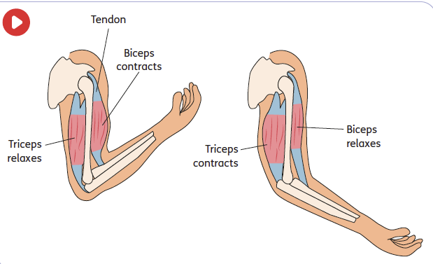
Antagonistic muscle pairs
When the biceps contracts, it pulls on the tendon causing the radius to move up, raising the lower arm. The triceps relaxes.
Antagonistic muscle pair: A pair of muscles that work as opposites by contracting and relaxing to control movement
The biceps and triceps are an example of an antagonistic muscle pair.
When the triceps contracts, it pulls on the tendon to move the ulna, straightening the lower arm. The biceps muscle relaxes.

Slide 21
Learning check
Explain the term ‘joint’ in reference to the human body.
A joint is a place in the skeleton where two or more bones meet.
Name the three different types of joints.
– Immovable joints
– Slightly movable joints
– Synovial joints
What is the function of cartilage in a joint?
Cartilage is the connective tissue that reduces the friction between bones during movement.
CLICK HERE FOR ANSWER
CLICK HERE FOR ANSWER
CLICK HERE FOR ANSWER

Slide 22
Learning check
What is a synovial joint?
A synovial joint is a freely movable joint that allows movement of the limbs.
Compare a ‘ball and socket joint’ to a ‘hinge joint’.
A ball and socket joint allows for movement in all directions such as in the shoulder and hip. A hinge joint allows movement in one direction only such as in the knee or elbow.
Distinguish between ligaments and tendons.
A ligament is the connective tissue that attaches bone to bone. A tendon is the connective tissue that attaches muscle to bone.
CLICK HERE FOR ANSWER
CLICK HERE FOR ANSWER
CLICK HERE FOR ANSWER

Slide 23
Learning check
Describe how an antagonistic muscle pair works.
An antagonistic pair of muscles such as in the arm, work as opposites by contracting and relaxing to control movement. When the biceps contracts, the arm moves up and at the same time the triceps relaxes. Then when the triceps contracts, the arm moves down and the biceps relaxes.
CLICK HERE FOR ANSWER

